Slide 1
C.A.P.E
June 27,2018

Slide 2
About the CACP RF
Mission
Promote the creation, use and sharing of collaborative research in Canadian policing
Vision
Enabling evidence-based decisions in policing
(Evidence-based decision making is integral & foundational to policing)
Established: 1982
Reborn: 2009
Programming: High quality, innovative (mission-based) programming to meet the needs of the policing community
Engagement & Partnerships: Engage, consult and collaborate with professional and community partners to build capabilities in policing research

Slide 3
About the CACP RF
Guiding Principles
Research is inclusive
Research is cost effective
Research is Canadian
“We have never had a national body of Canadian Police Knowledge. All too often we look to the US or the UK for solutions. The time is now for a hub of information that is Canadian and inclusive.”
Chief Robert Lunney (Rtd.)

Slide 4
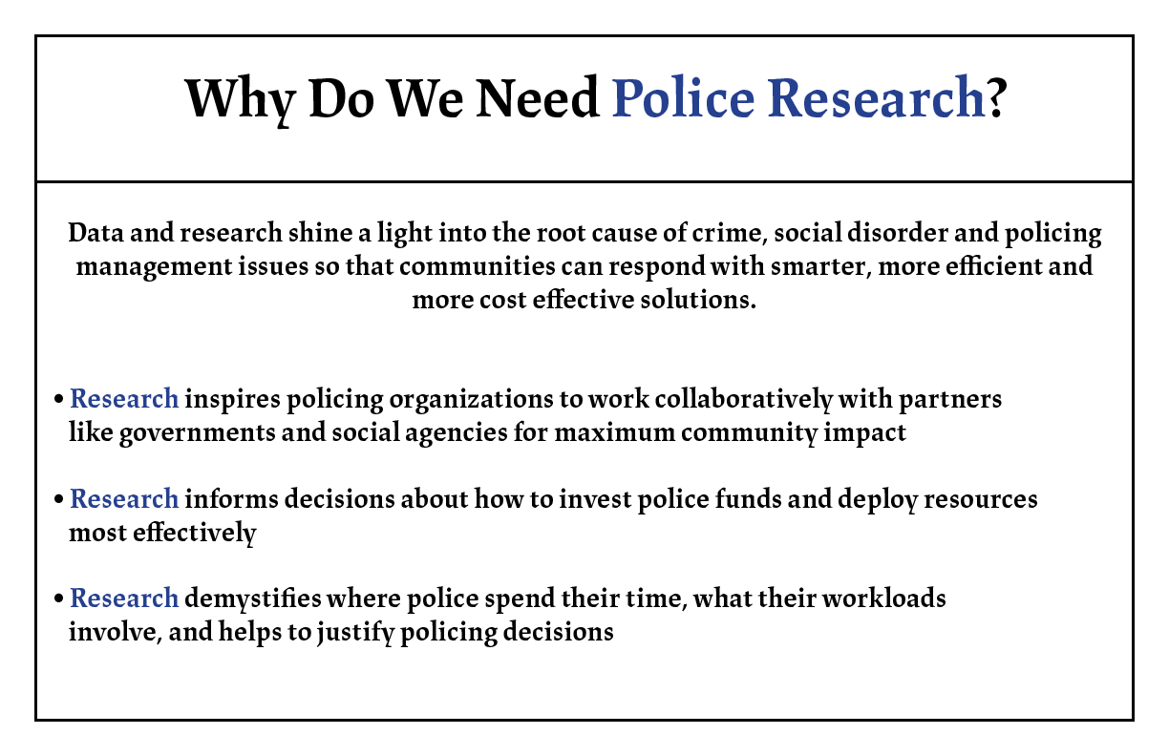

Slide 5
About the CACP RF
Mission
Promote the creation, use and sharing of collaborative research in Canadian policing

Slide 6


Partnerships
Create
White Papers
The Right Decision
The dollars and sense of policing nad community safety
Canadian Policing Research Catalogue
  Public Safety Canada Library
  Over 9,000 documents

Slide 7
Research Agenda
Create
Goal: Identify priorities and gaps in Canadian policing research, foster alignment with stakeholder groups, identify areas of collaboration
Driven by research needs of police leadership
Collaboration
  CACP Board, Committees, Members
  Academics
  Government
Delivered:
  Informative interviews
  National survey of police leaders and other stakeholders
  Consensus building workshops
Mobilization strategy:
  Executive summary
  Disseminate to members
  Engage stakeholders

Slide 8
2013 Research Agenda
Create
Human Resources
Funding and Financing
Community Engagement
Operations
Impact of Technology
Policing Models

Slide 9
2017 Research Agenda Renewal
Create
Public trust and confidence
Policing persons with mental illness
National security
Opioid overdoses
Cybercrime and technology
The root causes of substance abuse
Mental health and well-being of members

Slide 10




Making Research Accessible
Use
Annual policing research conference
Plenary session @ CACP annual conference
CACP RF Connect with access to Criminal Justice Abstracts with Full Text
CACP RF Plenary Session
Five for Five: Research Snapshots
Five speakers…five minutes…five new research topics!

Slide 11

Share
A secure forum to:
Find academic and police partners for collaboration
Share and learn best practices
Discuss everyday issues and questions with colleagues across the country
Access peer-reviewed research with Criminal Justice Abstracts with Full Text
Work collaboratively
Encourage evidence-based innovation
Build professional networks
A shared resource…with shared benefits
Access to research resources + connection and collaboration =
Evidence-based decision-making and program delivery

Slide 12
C.A.P.E
June 27,2018

