Slide 1
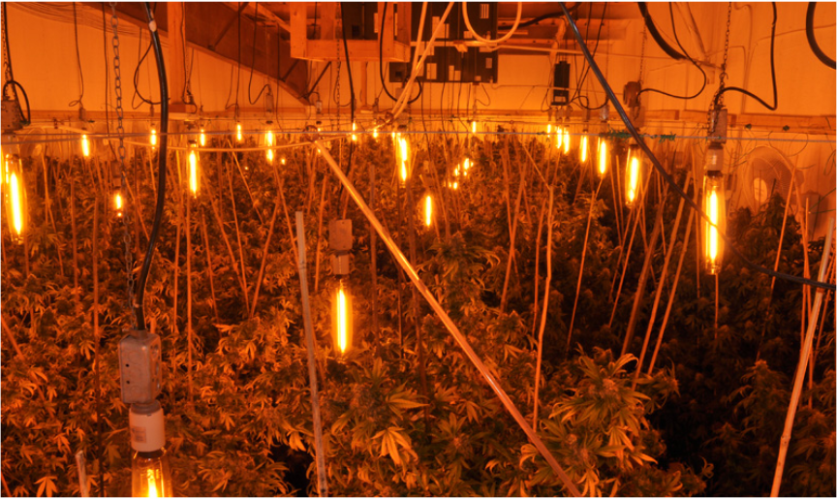

Introduction to Cannabis Legislation
CAPE 2018

Slide 2
What is CPKN?
Not-for-profit provider of e-learning for Canadian police and public safety
For Police By Police: governed by a national Board of Directors and guided by a National Advisory Committee
Collaborative: establish in response to a recognized need for efficient, cost-effective training through collaboration and sharing
An advocate for the advancement of police training & education

Slide 3

Board of Directors
CPKN’s Board of Directors sets the Strategic Objectives based on Public Safety needs.
Chief Kimberley Greenwood, Chair
Barrie Police Service
Supt. Michel Legault
Royal Canadian Mounted Police
Supt. Graham Beverly
York Regional Police
Supt. Peter Lennox (ret’d)
Toronto Police Service
Chief Jean Michel-Blais
Halifax Regional Police
Chief Paul Martin
Durham Police Service
A/Comm (ret’d) Roger Brown
Royal Canadian Mounted Police
Deputy Chief Barbara McLean
Toronto Police Service
Chief (ret’d) Devon Clunis
Winnipeg Police Service
Chief Constable Adam Palmer
Vancouver Police Department
ADM, Dale Larsen
Province of Saskatchewan
Chief Paul Pedersen
Greater Sudbury Police Service
Sandy Sweet
Canadian Police Knowledge Network

Slide 4

National Advisory Committee
The NAC is comprised of police training professionals from agencies across Canada.
Supt. Graham Beverly, Chair
York Regional Police
Christine Hudy
Royal Canadian Mounted Police
Supt. Martin Bruce
Vancouver Police Department
Insp. Joel Matthews
Calgary Police Service
S/Sgt. Stacy Clarke
Toronto Police Service
Simon Paré
Public Safety Canada
Marc Desaulniers
École nationale de police du Québec
Steve Schnitzer
Justice Institute of British Columbia
Paul Hebert
Ontario Police College
Tom Stamatakis
Canadian Police Association
Kerri Hatch
Ontario Provincial Police
Geneviève Tremblay
RCMP Learning and Development
S/Sgt. Lenore Hladky
Edmonton Police Service

Slide 5












































Network of Relationships

Slide 6

CPKN’s Vision and Mission
Vision
Mission
CPKN’s vision is to be the hub for collaborative, technology-enhanced learning and knowledge-sharing in the Canadian police and public safety community.
Build and support relationships and collaborations that enhance and evolve learning and training;
Respond to training needs with timely, relevant, high value, cost effective technology-enhanced learning opportunities and resources;
Support the community through competencies and standardized training; and
Demonstrate leadership in the integration of innovative learning models, tools, and technologies.

Slide 7
Courses Under Development
Analysis/StoryBoard
Evidence Based Policing
Pre-Production
Production
Victims Rights in Canada
Mental Health First Aid Public Safety
Introduction to Cannabis Legislation
Canadian Credible Leadership
NCO Promotion Process (RCMP)
Validation SME (RCMP)
Intimate Partner Violence Framework
The Science of Interviewing
Epilepsy and Seizure Response Training for Police Officers
Conflict of Interest
CPIC
Standards for Reporting Founded and Unfounded Incidents

Slide 8
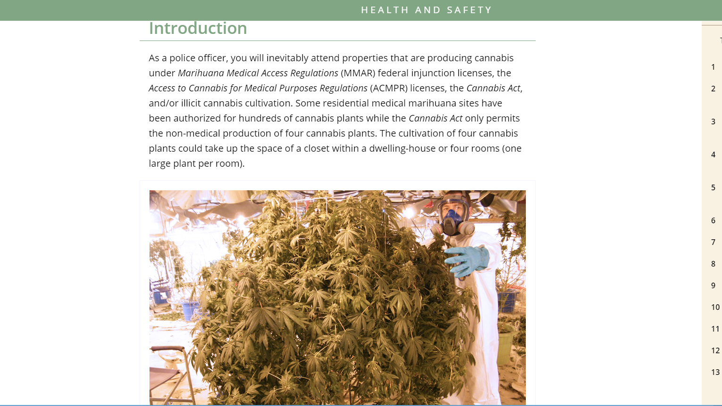
Introduction to Cannabis Legislation
Introduction
What is Cannabis
Offences and Penalties
Other Considerations
Health and Safety
Indigenous Communities
Applying What You Know
Conclusion

Slide 9

Course Timeline
4 modules in SME Review
Remaining 4 are in content development
Target date for release: July 2018

Slide 10

Interactive and Photo-rich design
The course contains interactive content to keep the learner engaged including:
Photos
Videos
Interactivity
Knowledge Checks

Slide 11
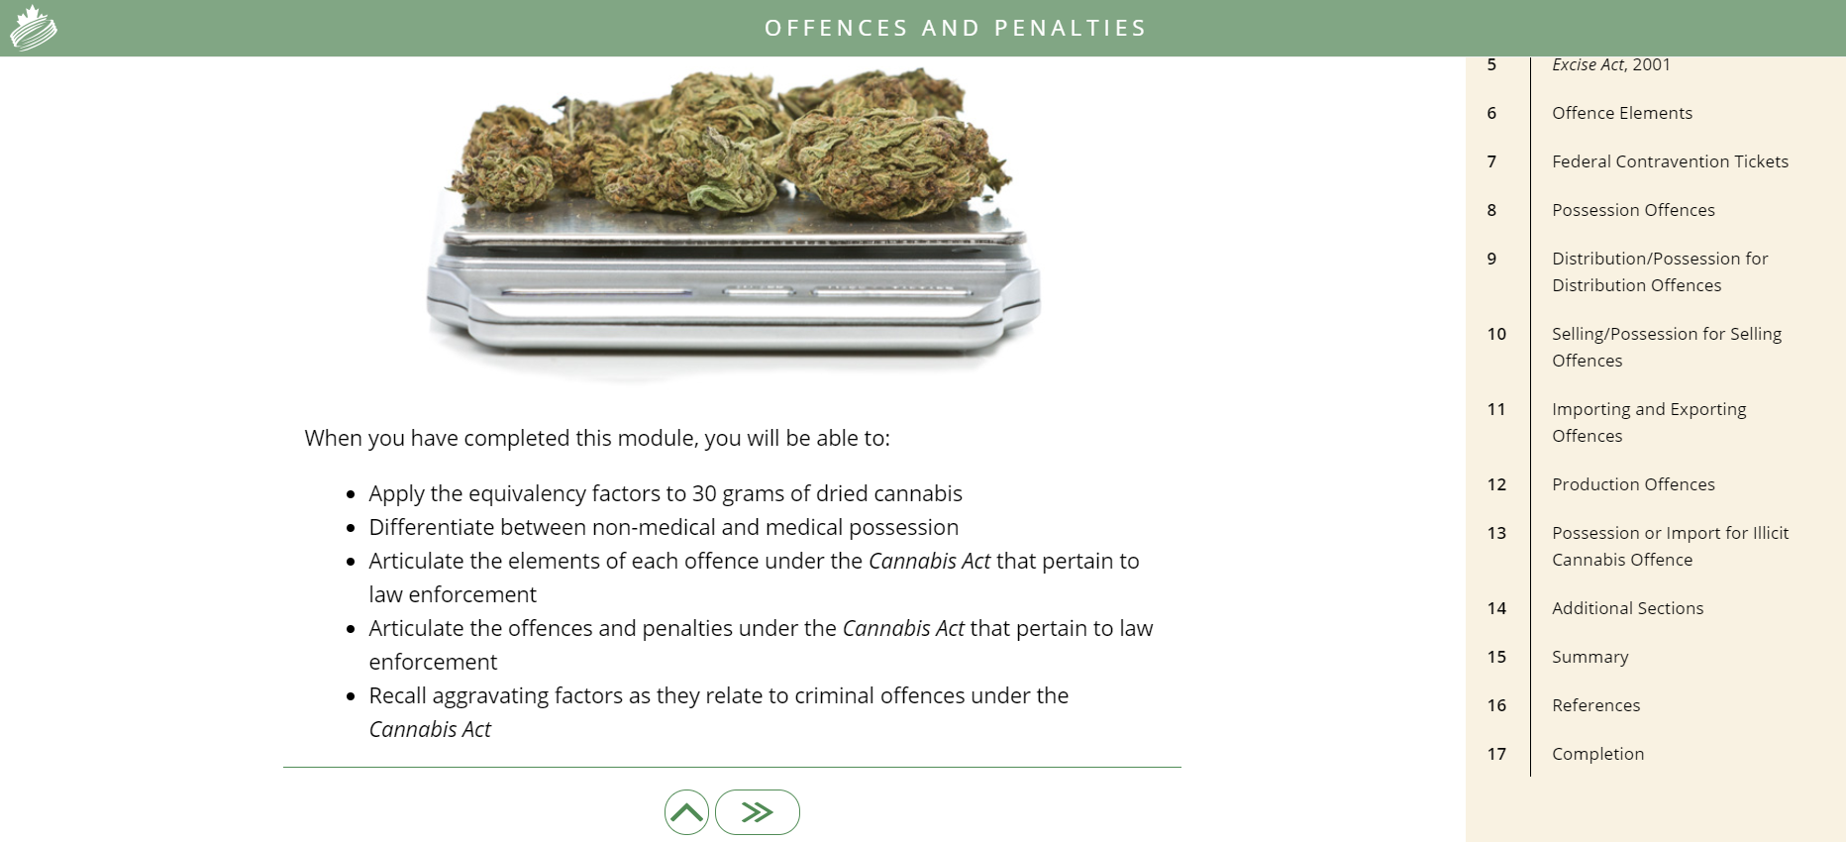
Other Courses and Services:
Hosting three online learning courses
  Introduction to Cannabis Legislation
  Basic Impaired Driving Detection Techniques
  Standardized Field Sobriety Test (SFST) Review and Introduction to Drug Impaired Driving
Repository also includes:
  in-class content on Cannabis Legislation, DID, SFST and DRE
  Job aids and reference material
  Is open to all Canadian police services
  Room to grow

Slide 12
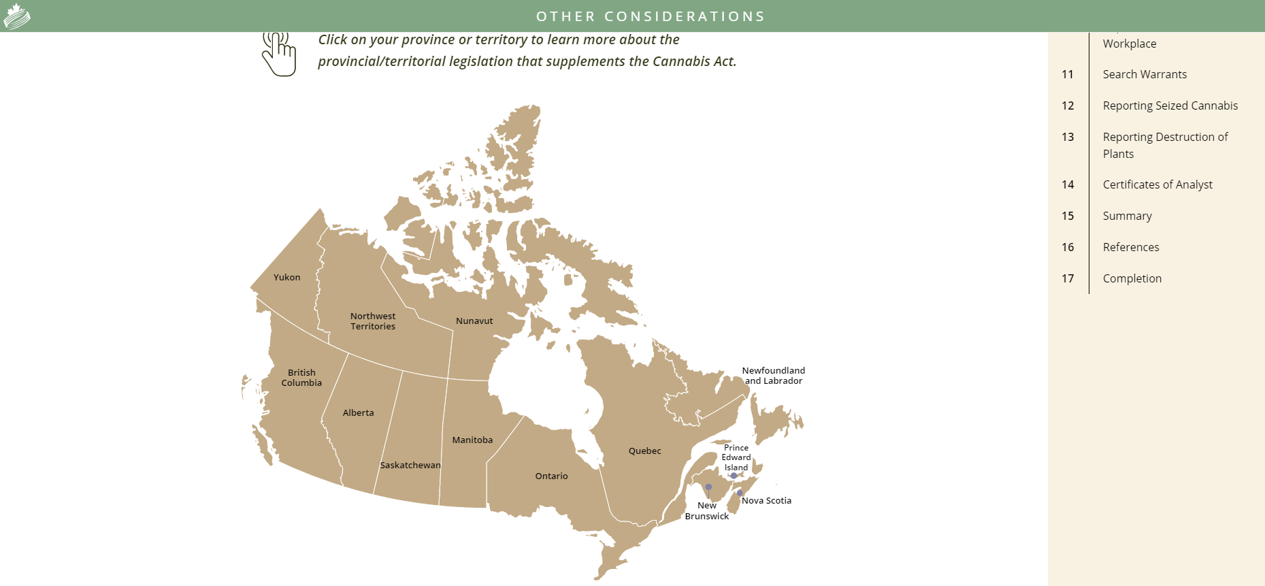
Provinces and Territories
Opportunity:
Add online module for provincial and territorial legislation
This content would be complimentary to the existing course

Slide 13


Slide 14


