Slide 1
Police research: A dialogue
Dr. Greg Anderson, Dean Applied Research & Graduate Studies

Slide 2
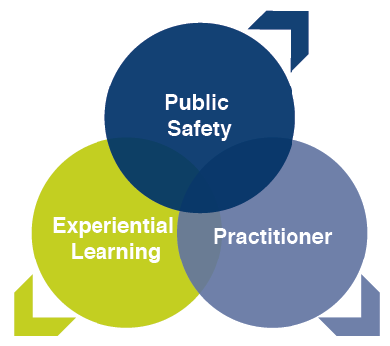
OUR RESEARCH PLAN GOALS
To advance the knowledge, theory and practice supporting the public safety professions
To examine the role and functions of, and the stressors on, public safety practitioners
To provide evidence supporting the experiential learning used to the create transformational learning environments

Slide 3
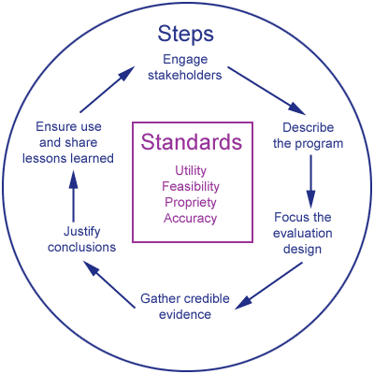
Why is Evidence-Based Research Important?
Policies and strategies that are evidence-based often produce better results, which can increase credibility and support
Better able to withstand public scrutiny

Slide 4
Areas of immediate research concern (2017)
Hiring
Training
Qualifying
Lifelong supports
Training
Qualifying
Hiring
Lifelong

Slide 5
Training
Qualifying
Hiring
Lifelong
Recruit selection
Assessment Centres
Polygraphs
Psychological measures (eg. Hardiness v Resilience)
Trait versus attribute
Bona fide occupational requirements
POPAT, PARE, TAPE
Grip strength

Slide 6
Training
Qualifying
Hiring
Lifelong
Training methods
Assessment of training
Applied, experiential learning
Use of simulations
Training schedules for skill development and retention
Use of force
Firearms
Fitness for duty
Physical and mental training

Slide 7
Training
Qualifying
Hiring
Lifelong
Skill retention
Qualifying score justification
Skill decay curves
Evidence for requalification schedule

Slide 8
Training
Qualifying
Hiring
Lifelong
Professional development opportunities
Link to employee retention and rank advancement
Leadership training and evaluation
Mental health strategies
Prevention and response
Training and education
Coping strategies
Stress recognition/reduction

Slide 9
Stress and Performance/Memory/Learning

Slide 10
Understanding Stress
A combination of a stressor and stress reactivity; a stimulus and response
Physical stress – response to the physical demands of police work
Psycho-social stress – response to the self-perceived imbalance between demands and resources

Slide 11
Perceived ability
Cognitive appraisal
Social environment
Load Carriage
Thermal
Barometric Pressure
Humidity
Physical
Environmental
Psycho-social
Stressor
Cognitive
Stress Reactivity
Spatial task
Memory task
Processing task
Evolution/Involution

Slide 12
Stress? No stress?
Determined by complex interactions between different brain regions, including the prefrontal cortex, the hippocampus, and the amygdala
Involved in the process of cognitive appraisal
link the currently experienced situation to past
modulates adaptive behaviour.

Slide 13
Anderson et al., 2002
Stressor
Hiring
Training
Personal Attributes
Coping Strategy
Cognitive Appraisal
Social Support
Pre/Post Employment
Training
Stress Reactivity
Sympathetic NS
Catecholamines
Glucocorticoids
Lazarus and Folkman (1984), Stress, Appraisal, and Coping, Springer, NY

Slide 14
Anderson et al., 2002
Stressor
Psycho-social Determinants
Biological Determinants
Personal Attributes
Cognitive Appraisal
Coping Strategy
Social Support
Sympathetic NS
Catecholamines
Glucocorticoids
Stress Reactivity

Slide 15
Stress has an impact!
On motor behavior (efficiency, recruitment, metabolism, etc)
Stress can impact both fine and gross movements, and balance
On memory and learning
The greatest negative impact will occur on those that perceive the task as a challenge or threat
Repeated exposure may reduce the threat or challenge appraisal and improve performance (habituate the response)
Understanding these are important to how we train individuals in high stress occupations
Important in understanding why two people can have different “truths”

Slide 16
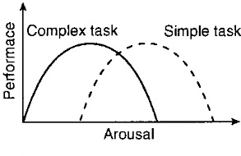
Novice Elite
Un-Trained Trained

Slide 17
Taxonomy of multiple memory systems
Conscious
Cognitive Memory
Un-Conscious
Habit Memory

Slide 18
Stress affects cognitive memory performance dependent on the timing of the stressor
Hippocampus dependent
memory processing, showing time-dependent
effects of the stressor on encoding, consolidation, and
retrieval
Stress before
Stress during
Stress during
Stress after
Stress after
Ness & Calabrese, Neural Plasticity, 2016

Slide 19
Stress and memory
Timing of stress influences memory quantity and quality
Emotionality and stress interact
Stress can enhance memory consolidation, particularly for emotionally relevant information, as well as impair memory retrieval
Stress modulates the engagement of multiple memory systems and favors habit memory over cognitive memory

Slide 20
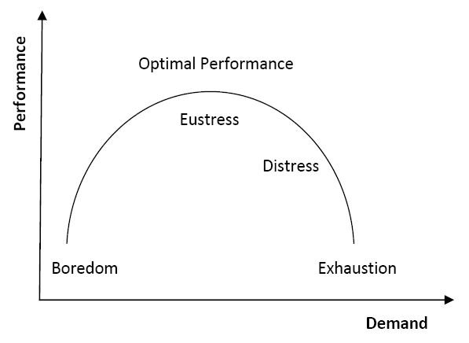
Eustress and optimal performance
Emotionality

Slide 21
Occupational Stressors = Organizational + Operational
 | Total | Municipal/ | RCMP^{b} |  | Total | Municipal/ | RCMP^{b}
 |  | Provincial Policeª |  |  |  | Provincial Policeª
 | Mean (SD) | Mean (SD) | Mean (SD) |  | Mean (SD) | Mean (SD) | Mean (SD)
Organizational Stressors |  |  |  | Operational Stressors
The feeling that different rules apply to different people (favouritism) | 4.15 (1.95) | 4.17 (1.93) | 4.22 (1.90) | Negative comments from the public | 3.45 (1.97) | 3.83 (2.00) | 3.80 (1.93)
Lack of resources | 4.29 (2.04) | 4.05 (2.00) | 4.95 (1.91) | Not enough time available to spend with friends and family | 3.54 (1.87) | 3.44 (1.81) | 3.83 (1.96)
Bureaucratic red tape | 4.44 (1.98) | 4.35 (1.91) | 4.83 (1.87) | Occupation-related health issues (e.g., back pain) | 3.62 (2.02) | 3.55 (2.01) | 3.94 (1.96)
Inconsistent leadership style | 4.44 (2.10) | 4.29 (2.09) | 4.56 (2.05) | Finding time to stay in good physical condition | 3.96 (1.85) | 3.87 (1.85) | 4.32 (1.78)
Staff shortages | 4.46 (2.08) | 4.48 (1.96) | 5.19 (1.60) | Fatigue (e.g., shift work, over-time) | 4.14 (1.99) | 4.07 (1.97) | 4.27 (1.99)
Total Mean Score, mean (SD) | 3.62 (1.33) | 3.58 (1.30) | 3.99 (1.31) | Total Mean Score, mean (SD) | 3.17 (1.28) | 3.15 (1.29) | 3.54 (1.36)

Slide 22
Canadian Institute for Public Safety Research & Treatment

Slide 23
Canadian Institute for Public Safety Research and Treatment: Associate Director Police Services
A coast-to-coast-to-coast multi-university team of Canadian researchers working with public safety broadly to identify the tools required to support the recognition, prevention, and treatment of health concerns facing Canadian public safety personnel and their families

Slide 24
Positive Screening Percentages for Recent Mental Disorders Based on Self-Report Measures
Mental Disorder Symptoms Among Public Safety Personnel in Canada (Canadian Journal of Psychiatry)
 | Gen ~ | Total Sample | Police | RCMP
PTSD | ~1.1-3.5 | 23.2 | 19.5 | 30.0
Major Depressive Disorder | ~7 | 26.4 | 19.6 | 31.7
Gen. Anxiety Disorder | ~3 | 18.6 | 14.6 | 23.3
Social Anxiety Disorder | ~6.7 | 15.2 | 10.0 | 18.7
Panic Disorder | ~1.6 | 8.9 | 5.9 | 12.0
Alcohol Use Disorder | ~7-25 | 5.9 | 5.8 | 3.9
Any mood disorder² |  | 29.0 | 21.3 | 34.7
Any anxiety disorder³ |  | 30.3 | 23.7 | 37.3
Any mental disorder⁴ | 10.1 | 44.5 | 36.7 | 50.2

Slide 25
Mental Disorder Count
Mental Disorder Symptoms Among Public Safety Personnel in Canada (Canadian Journal of Psychiatry)
 | Total Sample | Police | RCMP
0 mental disorders | 58.2 | 65.9 | 52.7
1 mental disorders | 15.1 | 13.8 | 14.8
2 mental disorders | 8.7 | 8.0 | 8.1
3 or more mental disorders | 18.0 | 12.3 | 24.4

Slide 26
Mental Disorder Symptoms Among Public Safety Personnel in Canada (Canadian Journal of Pain)
all PSP categories screened positively at substantial rates for several different OSIs
Demographic Comparisons
women screened positively more than men
persons with more years of service screened positively more
married persons screened positively less than others
university educated persons screened positively less than others
no differences based on age, ethnicity, or urban/rural location

Slide 27
Chronic Pain Prevalence Percentages and Locations
Chronic Pain Among Public Safety Personnel in Canada(Canadian Journal of Pain)
 | Gen ~ | Total Sample | Police | RCMP
Any Chronic Pain | 18.9 | 40.2 | 35.9 | 43.4
Lower back | 22.3 | 24.0 | 22.1 | 26.5
Shoulder | 6.1 | 17.6 | 14.7 | 19.6
Neck | 5.4 | 16.8 | 15.4 | 17.8
Arm | 2.2 | 11.1 | 10.6 | 12.5
Leg | 7.2 | 14.3 | 12.7 | 15.7
Hand | 2.8 | 10.9 | 9.8 | 12.0
Foot | 3.4 | 12.6 | 11.8 | 14.9
Headaches | 6.2 | 15.2 | 14.4 | 16.0
Other | - | 7.1 | 5.7 | 8.8

Slide 28
Chronic Pain Prevalence Percentages and Locations
Chronic Pain Among Public Safety Personnel in Canada(Canadian Journal of Pain)
 | Total Sample | Police | RCMP
Injury related to active duty | 40.2 | 39.6 | 54.4
Injury related to work other than active duty | 9.6 | 10.2 | 7.3
Injury not related to work | 16.2 | 18.9 | 8.5
Non-injury-related disease (e.g., osteoarthritis) | 11.2 | 10.0 | 7.8

Slide 29
Prevalence of Past-Year and Lifetime Self-Reported Suicidal Behaviour
Suicidal Ideation, Plans, and Attempts Among Public Safety Personnel in Canada (Canadian Psychology)
 | Gen ~ | Total Sample | Police | RCMP
Past Year
Suicidal Ideation | ~ 6 | 10.1 | 8.3 | 9.9
Suicidal Planning | ~ 2 | 4.1 | 3.4 | 4.1
Suicidal Attempt | ~ <1 | 0.3 | 0.2 | 0.2
Lifetime
Suicidal Ideation | ~ 11 – 14 | 27.8 | 20.5 | 25.7
Suicidal Planning | ~ 4 – 5 | 13.3 | 8.9 | 11.2
Suicidal Attempt | ~ 1 - 4 | 4.6 | 2.1 | 2.4

Slide 30
Meaningful Program Evaluation

Slide 31
Prevalence of exposure to mental health training among PSP categories (n=4,020)
Training Type | Mun/Prov Police (%) | RCMP (%)
None | 25.4 | 42.0
Any Training | 74.6 | 58.0
Critical Incident Stress Management | 37.5 | 31.5
Critical Incident Stress Debrief | 34.3 | 29.7
Mental Health First Aid | 18.6 | 14.2
Peer Support | 27.1 | 18.6
R2MR | 51.9 | 33.8

Slide 32
Exposure to training by mental health measures
Type of Training | Mental Health Knowledge Scale, MAKS range (23-75) | Stigma Scale, OMSWA range (11-55) | Mental Health Resilience Scale, BRS range (6-30)
CISM | 61.44 | 20.77 | 22.31
CISD | 61.14 | 20.79 | 22.36
MH First Aid | 61.87 | 20.11 | 22.35
Peer Support | 61.54 | 20.17 | 22.38
R2MR | 61.83 | 20.02 | 22.04
Any Training | 61.38 | 20.68 | 22.02
No Training | 60.38 | 21.39 | 20.90

Slide 33
What is Resilience?
Definition:
The ability to engage in adaptive behaviors in the face of stress, trauma, adversity or threat.
Qualities of resilience:
Recognizing and accepting the reality stress plays in our lives
Strong problem solving skills
Threat appraisal
Self-awareness of our stress reactions
Strong social connections
Notes:
There are many ways to define the concept of resiliency. The definition we have chosen for this presentation as well as for the project as a whole is the ability to engage in adaptive behaviours in the face of stress, trauma, adversity, or threat.
This definition and many other definitions touch upon several key factors such as adaptation, balance, competence, determination, optimism, and acceptance. Some of these definitions include physiological and behavioural stress response. W
ith these in mind, we can then begin to list or describe what are the qualities of resilience, much like I did using the examples on the first slide. For example, some of the qualities of resilience relate back to one’s social connections and the ability to engage with colleagues and friends in time of need rather than isolation.

Slide 34
Scan: Approaches to building resiliency
Reactive programs
Peer-to-peer programs
Psychological first aid
Debriefing models
Proactive/prevention approaches
Road to Mental Readiness (R2MR-MHCC)
College and university programs/certificates
Specific course work and skill development
Notes:
Recently, proactive approaches to better prepare first responders to the likely expectation that they will be exposed to traumatic events have emerged.
Resiliency is defined as: The ability to engage in adaptive behaviours in the face of stress, trauma, adversity or threat (Wagnild, 2011).
Other terms: ‘hardiness’ or the importance of ‘mentally readiness/toughness’
Obviously programs can be both reactive and proactive but they have been separated out to highlight when they are likely to be delivered: after the event for reactive and before an event for proactive.
There are numerous reactive programs. Some of these have been shown to be empirically very good at helping people recover from an incident. I won’t go into much detail here other than they exist in various fashions.
The proactive programs, or those that are intended to mitigate problems before they happen, are often part of a larger reactive program policy that pre-exisits. For example, an organization may provide reactive services, should the need arise, as well as proactive ones. Proactive programs are relatively speaking, a new idea and come in various forms.

Slide 35
Road to mental readiness (R2MR)
Objectives
Reduce the stigma associated with mental illness,
small to moderate decreases in mental health stigma
2. Increase awareness around the link between stress and mental wellness recognizing the symptoms of poor mental health,
p>0.05 (nonsig)
3. Increase mental resilience,
p>0.05 (nonsig decrease in mental health disorders)
4. To have members more aware of the various psychosocial support resources which may be available to them
participants described the training as helpful.

Slide 36
A longitudinal assessment of the road to mental readiness training among municipal police Cognitive Behavioural Therapy (In Press)
Study assessed the impact of the MHCC R2MR training at pre-training, post-training, 6-month follow-up, and 12-month follow-up on several factors in a sample of Canadian municipal police officers
The multilevel analytic results suggested there were no statistically significant changes following the intervention in:
symptoms of depression,
anxiety,
stress,
posttraumatic stress,
alcohol use,
mental health knowledge,
resilience, or
workplace engagement

Slide 37
What we did…
Engaged stakeholders (paramedics, students)
Identified problem
Lack of training
Expert working group
Create a solution
Implementation plan
Evaluation plan
Credible evidence
Justified results
Disseminated findings

Slide 38
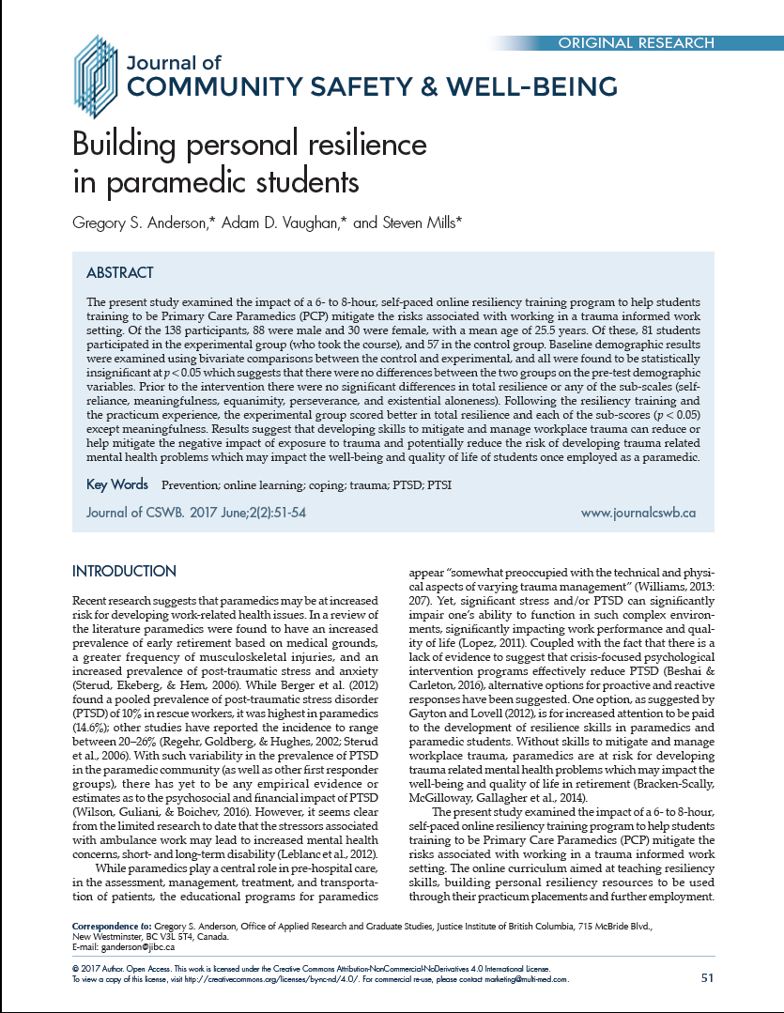
JIBC COURSE
https://resiliency.jibc.ca/
1) Build resilience and coping strategies
2) No cost to take the course/Open-access
3) Intended for and available to a wide audience of emergency responders (e.g., volunteers, civilians, first responders)
4) Currently testing to see how effective it is

Slide 39
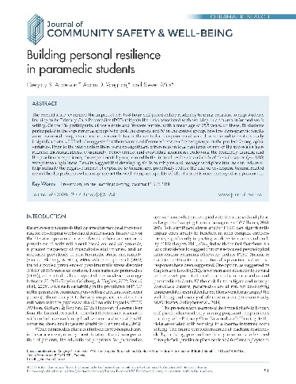
JIBC Open Resilience Resource
Δ=32.80 between pre and post in experimental group
Δ=27.03 between post control and post experimental group
* = p<0.05
Control Group Experimental Group
Pre Post Pre Post
Self-reliance 29.30 30.03 - 29.00 37.00 *
Meaning 28.65 28.91 - 28.06 31.53 -
Equanimity 27.59 28.42 - 27.02 34.00 *
Perseverance 28.75 29.12 - 28.22 33.27 *
Aloneness 30.02 29.85 - 28.25 36.68 *
Total Score 144.07 146.33 - 140.56 173.36 *
Notes:
I have highlighted the score of interests in red. Here, you can see the total post-test resiliency scores for the control group and the experimental group. Both groups increased but the experimental group increased more with a difference of about 27 points. I should mention that simply retaking the Resiliency Scale does not mean your score will increase. For example, in the Ritchie et al (2014) paper, the control group’s average RS score decreased between pre and post tests.

Slide 40
Think about the context
Context Matters:
Are the findings generalizable to other contexts
Exposure to similar trauma in both professions
Similarity in operational role
Other training support and preparation
Frequency of training
Who responded / population studied
Are there subsets within the population

Slide 41
Assaults Against Police Officers

Slide 42
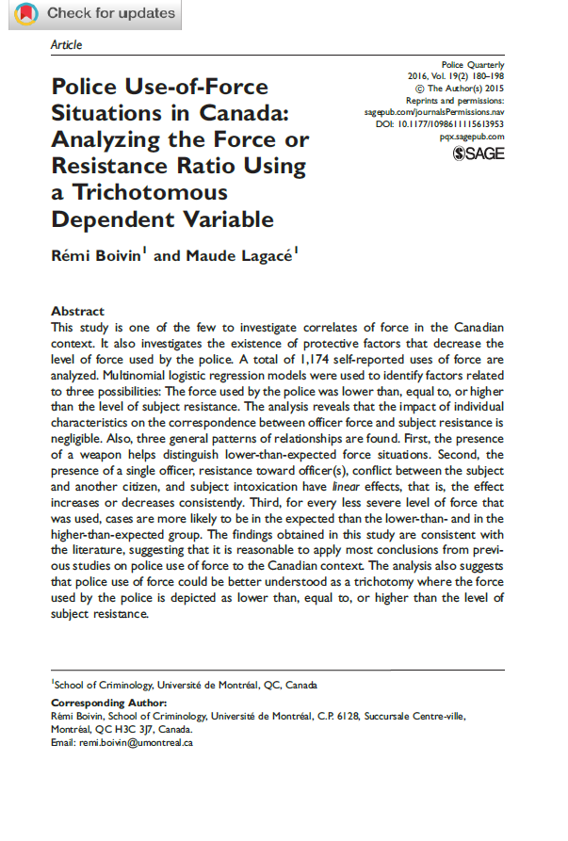
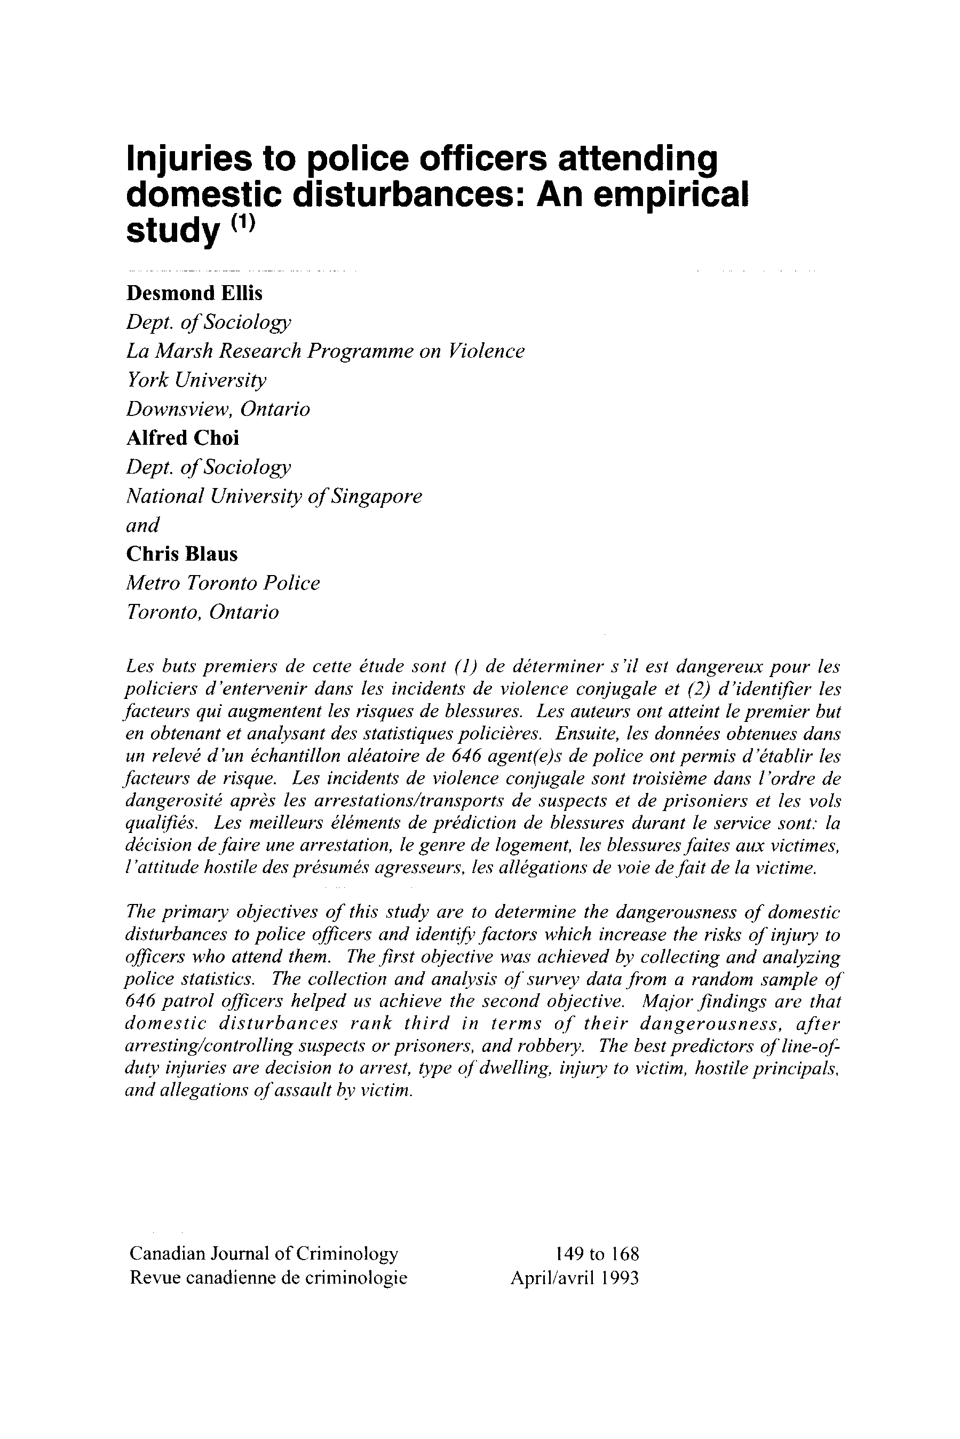
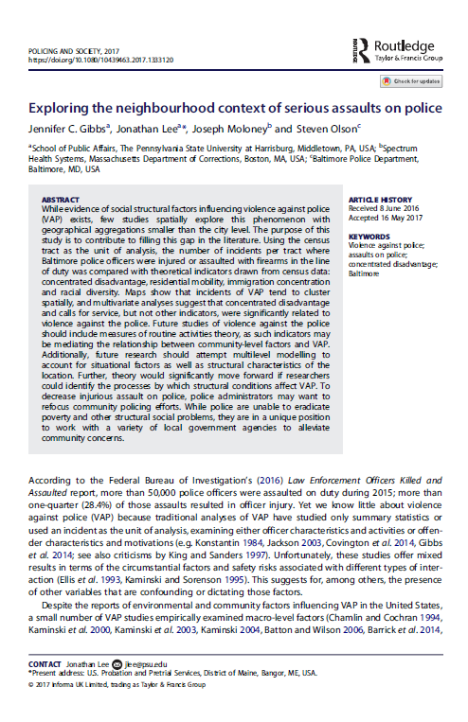
Assaults Against Police Officers (AAPO)
Academic narrative on AAPO is largely based in the US
Limited (and somewhat dated) research in Canada
Much of the evidence speaks to the relationship between violence/assaults and 1-5 areas
1) Contextual and organizational information
2) Level of response/use of compliance tools
3) Police officer characteristics
4) Perpetrator and situational characteristics
5) Effect of violence on POs*
Main Research Question: How does 1-4) effect 5) or the temporal impact (direct and indirect physical + psychological) of an assault ?

Slide 43
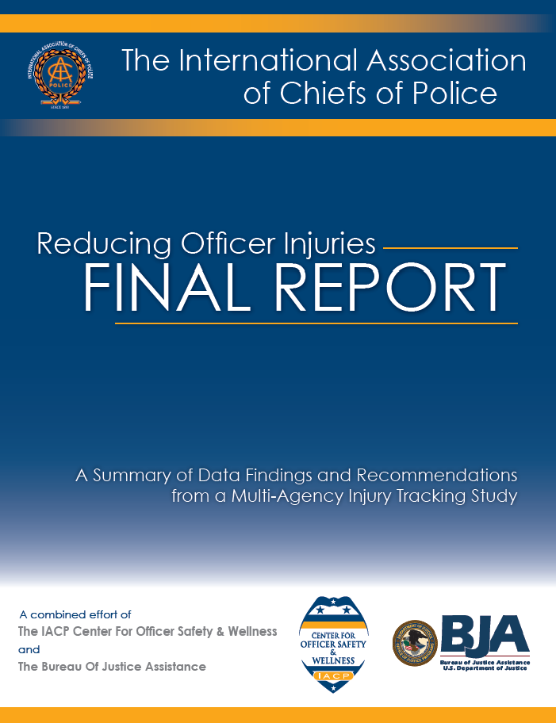
Methods
Participating agencies
All independent police services in BC were consulted to participate
Eligible participants
Active duty POs working for at least 12-months and 50% of their time as a PO requires them to work in the field.
Assaults were self-defined as per S.270 of the Code
Survey construction, review, translation
Existing research (e.g., IACP, RCMP), seconded POs
83 questions covering demographic information and the five previously mentioned categories

Slide 44
Overview of Results (N=376, n=135 assaulted)
376 respondents, 135 assaulted w/in the past year
1) No statistically significant differences in the policing contexts (population size and shift typology) between assaulted and non-assaulted POs
3) Officer characteristics. Younger, less experienced POs, and those with a lower rank. No difference for level of fitness, BMI, level of education.
Assaulted POs tended to sleep fewer hours/night (about 20 mins less/night)
those who had hard physical control training

Slide 45
Policies and strategies that are evidence-based often produce better results, which can increase credibility and support.
Notes:
Recently, proactive approaches to better prepare first responders to the likely expectation that they will be exposed to traumatic events have emerged.
Resiliency is defined as: The ability to engage in adaptive behaviours in the face of stress, trauma, adversity or threat (Wagnild, 2011).
Other terms: ‘hardiness’ or the importance of ‘mentally readiness/toughness’
Obviously programs can be both reactive and proactive but they have been separated out to highlight when they are likely to be delivered: after the event for reactive and before an event for proactive.
There are numerous reactive programs. Some of these have been shown to be empirically very good at helping people recover from an incident. I won’t go into much detail here other than they exist in various fashions.
The proactive programs, or those that are intended to mitigate problems before they happen, are often part of a larger reactive program policy that pre-exisits. For example, an organization may provide reactive services, should the need arise, as well as proactive ones. Proactive programs are relatively speaking, a new idea and come in various forms.

Slide 46
Dr. Greg Anderson, PhD ganderson@jibc.ca
Research Gate: https://www.researchgate.net/profile/Gregory_Anderson5
Google Scholar: https://scholar.google.ca/citations?user=Ge4CVBMAAAAJ&hl=en
www.cipsrt-icrtsp.ca

