Slide 1

Investigative Skills
Education Program
(ISEP)
Program Overview
2016-2018

Slide 2
What is the Investigative Skills Education Program?
Provides a relevant, consistent, and structured approach to the specialized education required by investigators
Promotes continuous and progressive education, based on competencies corresponding to the skill level of the investigator
Utilizes a blended learning format
(online, classroom, scenario-based)
Hands-on, experiential, authentic

Slide 3
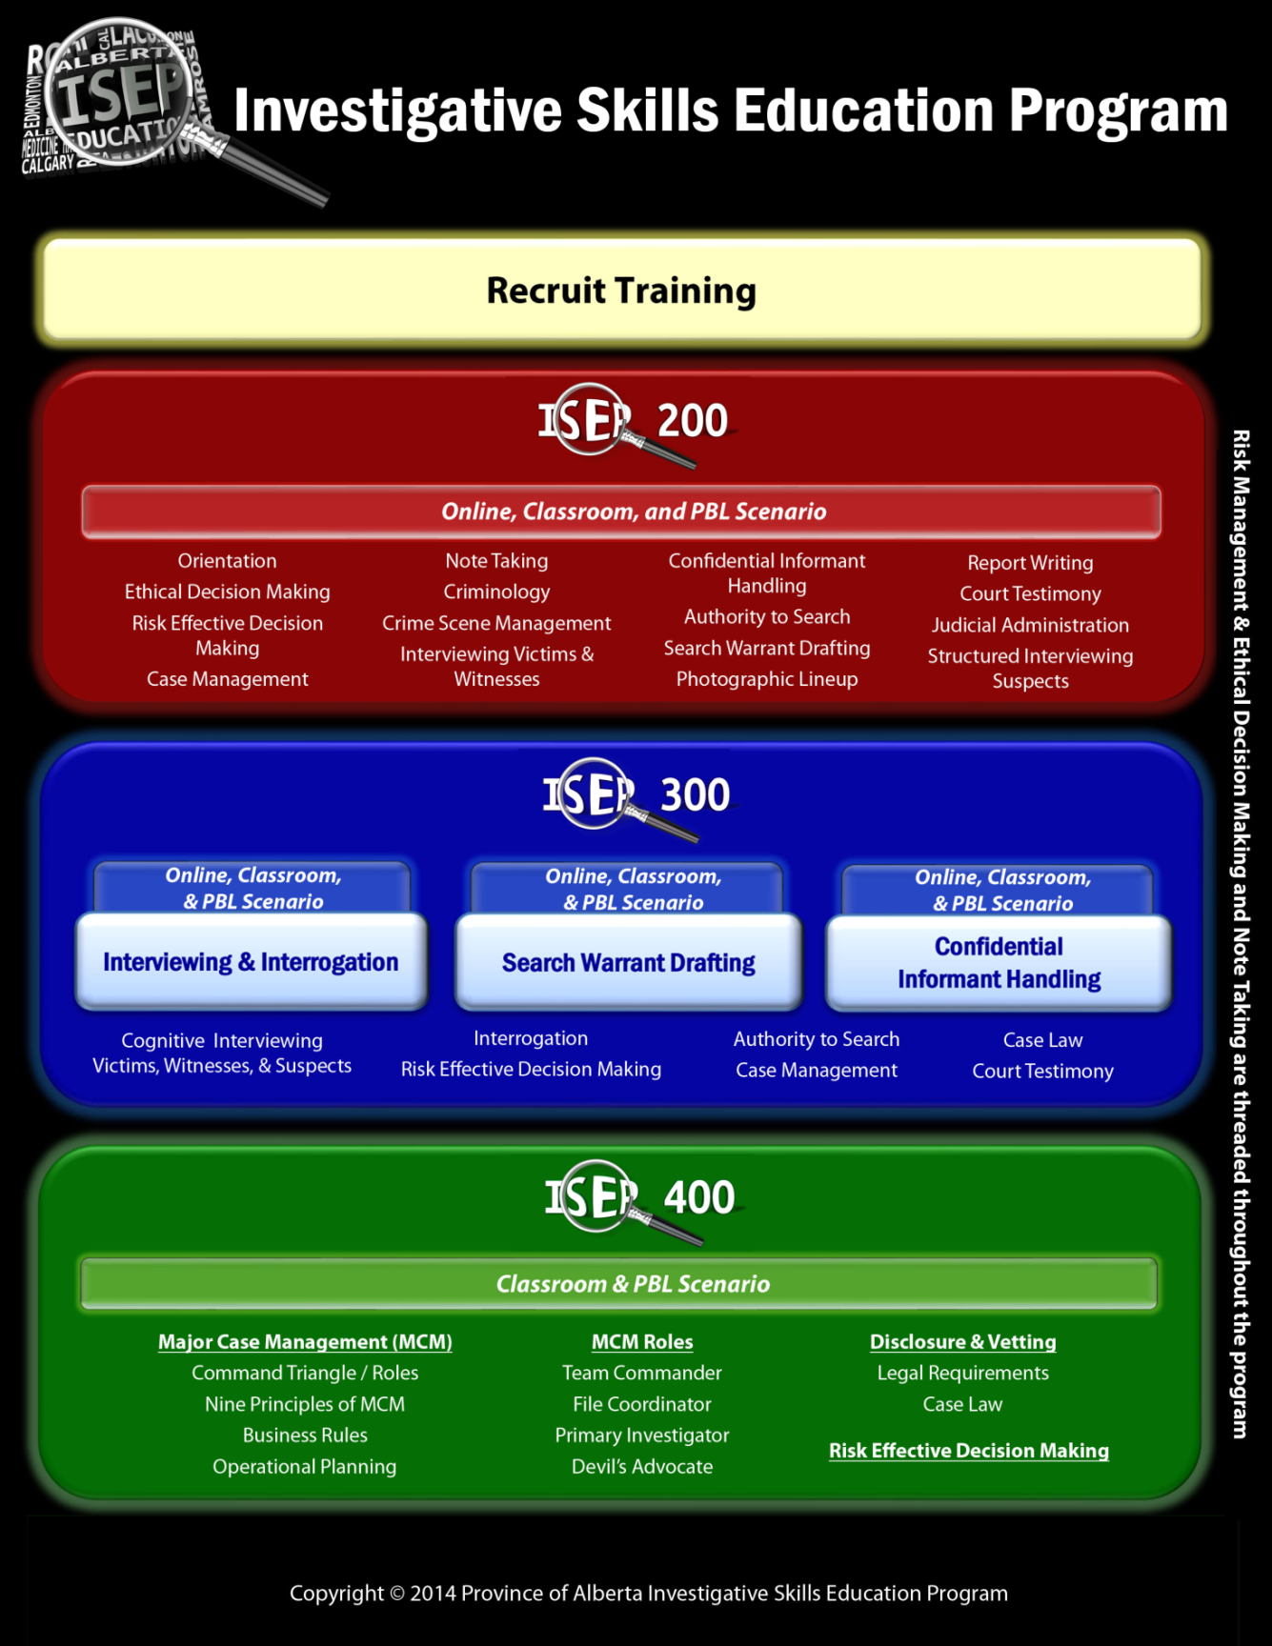

Slide 4

Recruit Training
All Alberta police and peace officers who have successfully completed their agency’s basic training program or experienced officer training will have achieved certification and met the prerequisite for entry into ISEP programming.

Slide 5
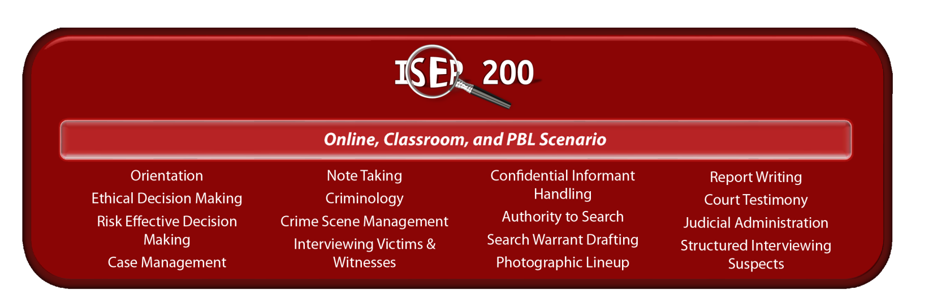
Level 200 Investigator Certification
Duration:
Online: 13 to 14 hours
Classroom: 5 consecutive days (40 hours training)

Slide 6

Audience:
  Members with 0-3 years of experience
  Officers required to complete a standardized investigative skills program for a more consistent investigative approach.
Focuses on basic competencies of criminal investigations, with emphasis on strategic investigative planning, decision making, providing the elements of a charge, and evidence collection.

Slide 7
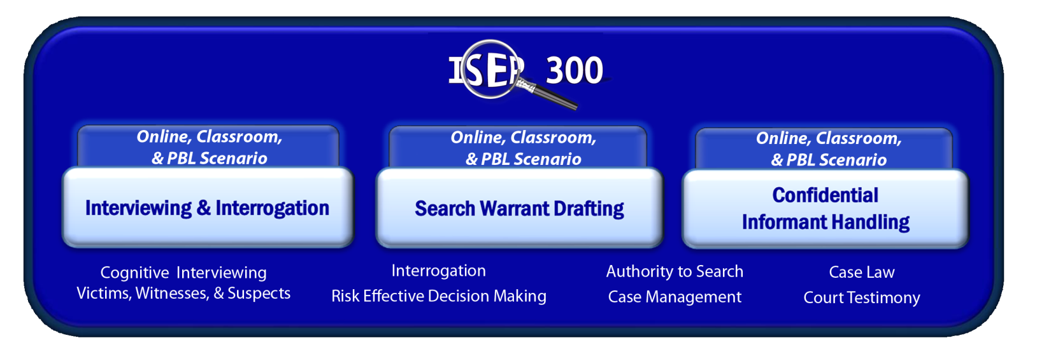
Level 300 Investigator Certification
Duration of Each Course:
Online: ~4 to 8 hours
Classroom: 4 consecutive days (40 Hours Training)

Slide 8

Audience:
  Senior constables
  Newly promoted officers who are moving into an investigative unit requiring more advanced training
Consists of 3 standalone blended learning courses:
  Interview and Interrogation
  Search Warrant Drafting
  Confidential Informant Handling

Slide 9
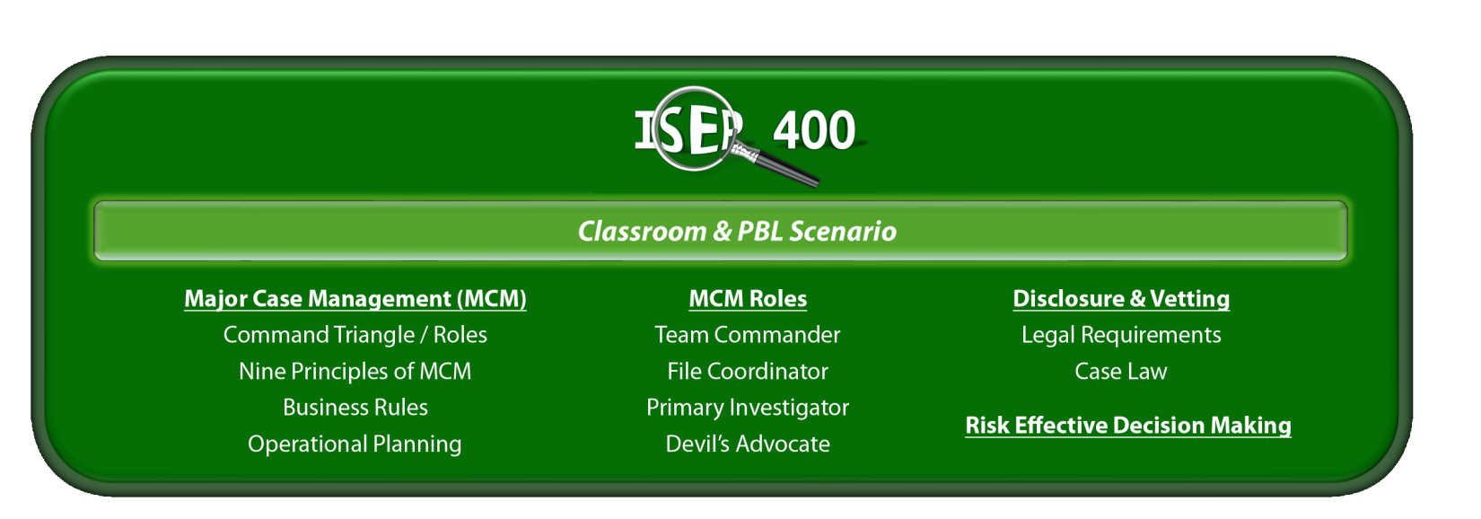
Level 400 Investigator Certification
Serious Investigations:
Introduction to Major Case Management
Duration:
Classroom: 5 consecutive days

Slide 10

Audience:
  Members who are working in or about to work in an investigative area
  It is preferred that candidates have a solid and successful background in investigative core skill sets.
Evolved significantly since original ISEP 400 course (2007-2014)
Notes:
The original ISEP400 involved a seven day session and utilized a hybrid of lecture based materials combined with a commercial shop breaking offence as its core scenario material. Success on the course was measured by the candidate’s, (working in their assigned groups), ability to effectively draft a search warrant, informant debrief, investigative timeline and other investigative focussed documents. Candidates would then assemble these assorted documents into a “paper based” investigative file and they would receive a group mark for the work.

Slide 11
Provides introduction to MCM, the roles and responsibilities within the MCM triangle, and how the structure can be applied to serious investigations.
Course participants engage in practical exercises that allow them to develop their functional skills as a Primary Investigator and File Coordinator.

Slide 12

2016 Course Stats
Calgary Police Service
Course | Total # of Sessions | Total # of Students
ISEP 200 | 4 | 84
ISEP 300 CI Handling | 3 | 48
ISEP 300 Search Warrant Drafting | 2 | 32
ISEP 300 Interview & Interrogation | 3 | 45
ISEP 400 | 1 | 25
TOTAL: | 13 | 234
Other agencies that have participated in our courses:
RCMP
MHPS
Solicitor Generals Office
Calgary Bylaw
ASIRT
Notes:
From January to October CPS has held a total of 10 ISEP courses. The breakdown of the courses is as follows:
ISEP200 x 2 courses - total of 48 students
ISEP300 I&I x 3 courses - total of 45 students
ISEP300 SWD x 2 courses - total of 32 students
‎ ISEP300 CIH x 2 courses - total of 32 students
ISEP400 x 1 course - total of 25 students
Total students trained to date - 182
Between November to December CPS has 3 more ISEP courses scheduled. The breakdown of those courses are as follows:
ISEP200 x 2 courses - total of 36 students
***one of these courses is a Direct Entry Officer Class***
ISEP‎300 CIH x 1 course - total of 16 students
Total of 52 additional students trained
Total officers projected to be trained in 2016 is 234
Several agencies have sent their officers to CPS for training in the ISEP program. These agencies include:
RCMP - SWD
MHPS - ISEP200 and ISEP400
Solicitor Generals Office - ISEP200
Calgary Bylaw - ISEP200
ASIRT - ISEP300 I&I
The CPS ISEP Coordinator has received very positive feedback from these agencies as they are impressed with the course content and appreciate recieving a high level of training that provides uniformity of best practices.

Slide 13
2017 Course Load
Calgary Police Service
Course | Total # of Sessions | Total # of Students
ISEP 200 | 6 | 120
ISEP 300 CI Handling | 3 | 48
ISEP 300 Search Warrant Drafting | 3 | 48
ISEP 300 Interview & Interrogation | 3 | 45
ISEP 400 | 2 | 48
TOTAL: | 17 | 309
Notes:
The CPS ISEP program projects the following course load for 2017:
ISEP200 x 6 courses - total of 120 students
ISEP300 I&I x 3 courses - total of 45 students
ISEP300 SWD x 3 courses - total of 48 students
‎ ISEP300 CIH x 3 courses - total of 48 students
ISEP400 x 2 courses - total of 48 students
‎
Total students forecasted to be trained in 2017: 309
Additionally the CPS ISEP Coordinator is attending the MHPS in 2017 to assist with their roll out of the ISEP400 course.
Due to the amount of junior officers at CPS and the high demand for investigative training for these officers it is imperative that CPS offers a large amount of ISEP200 courses not just in 2017 but for the foreseeable future.

Slide 14
ISEP Contact Information
Sgt. Regan Owen
Edmonton Police Service ISEP Coordinator
780-405-6422
regan.owen@edmontonpolice.ca
Sgt. Russ Williamson
Calgary Police Service ISEP Coordinator
403-428-8978
rwilliamson@calgarypolice.ca

