Slide 1
Dr Ian Hesketh
Organisational Development
Wellbeing Lead
College of Policing
Professionalisation of Policing
CAPE 2018
Tuesday 26th June 2018
@IanHesky
@CollegeofPolice
www.college.police.uk

Slide 2
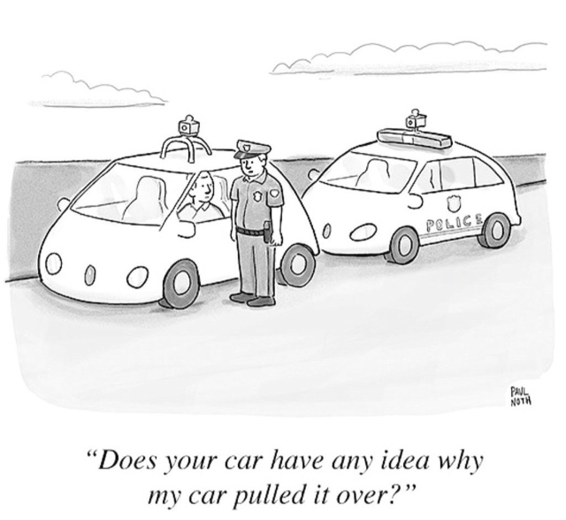

Slide 3

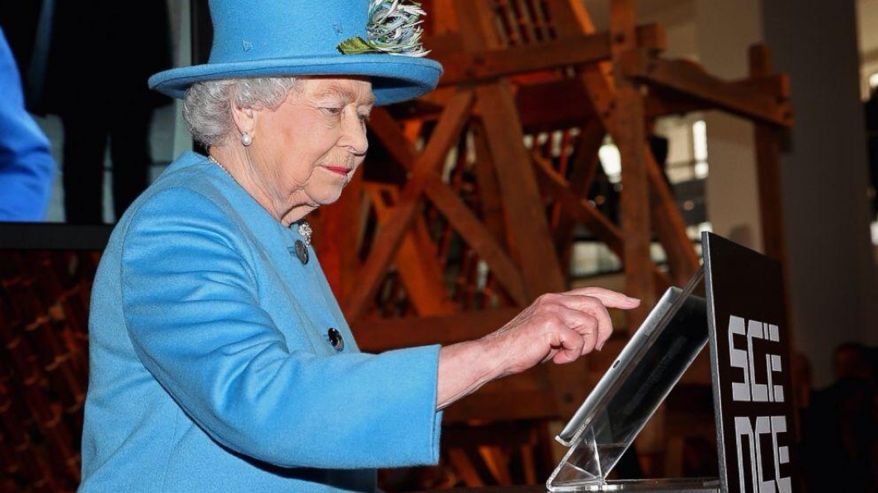

Slide 4


Slide 5
Recent Publications….
Hesketh, I., Cooper, C. and Ivy, J., (2018). ‘Asset Rich, peelers poor: Measuring and Efficacy of Resilience training in Policing’ Under Review.
Hesketh, I., Cooper, C., Ivy, J., and Bishopp, S. (2018). ‘Evidence-Based Training and the Professionalisation of Policing: Inextricably Linked.’ Police Practice and Research: An International Journal. Under Review. Taylor & Francis
Tehrani, N., Hesketh, I. (2018). ‘The role of psychological screening for emergency responders.’ International Journal of Emergency Services. Emerald. Under Review.
Hesketh, I., Cooper, C. and Ivy, J. (2018). ‘Leading the Asset: Resilience Training Efficacy in UK Policing' Police Journal: Theory, Practice and Principles. Sage
Hesketh, I., Cooper, C. (2018). ‘Wellbeing at Work: How to Design, Implement and Evaluate an Effective Strategy.’ Forthcoming Book (July 2018). Koganpage
Hesketh, I., Tehrani, N. (2018). ‘Psychological Trauma Risk Management in the UK Police Service.’ Journal of Policing. Oxford University Press. Under Review.
Hesketh, I. (2017). ‘Wellbeing in Law Enforcement: Progress and Prospects.' Conference Paper. Presented at FBI Conference. Bristol, UK. 23rd -27th September, 2017
Hesketh, I., Graham, L. (2017). ‘Theory or not Theory: That is the Question.’ Australian Journal of Evidence Based Policing. Vol 9 (1), pp 10-13.
Hartley, J., Hesketh, I., Chase, S. (2017). ‘Education and research for 21st century policing: Collaboration, competition and collusion.’ European Police Science and Research Bulletin. Issue 14. CEPOL
Hesketh, I., Williams, E., (2017). 'A New Canteen Culture: The Potential to Use Social Media as Evidence in Policing.' Policing. Vol 11 (3). pp 346-355. OUP
Hesketh, I., Tehrani, N., Harrison, J. (2017). ‘Psychological Risk Management: Introduction & Guidance.’ College of Policing Ltd.
Hesketh, I., Cooper, C., (2017). 'Measuring the People Fleet: General Analysis, Interventions and Needs.' Strategic HR Review. Vol 16 (1). Emerald
Hesketh, I., Cooper, C. and Ivy, J., (2017). ‘Well-being and Engagement: The Key to Unlocking Discretionary Effort?' Policing. 11 (1): 62-73.
Hesketh, I., Hartley, J. (2016). ‘Public Value: A new means to peel an apple?’ European Police Science and Research Bulletin. Issue 13. CEPOL
Hesketh, I. (2016) 'Change Management in Policing: The Criticality of Workforce Wellbeing.' Conference Paper. Presented at HR Congress. Amsterdam, Netherlands. 28th-29th November
Hesketh, I. (2016). '21st century policing research-based learning and practice.' Conference Paper. Presented at CEPOL European Police Research and Science Conference. Budapest, Hungary. 5th -7th October
Hesketh, I. (2016). 'Theory or not Theory? …Reducing the Evidence-Practice Gap.' Conference Paper. Presented at CEPOL European Police Research and Science Conference. Budapest, Hungary. 5th -7th October
Hesketh, I. (2016). 'Productivity and the importance of Wellbeing.' Conference Paper. Presented at the Excellence in Policing Conference. Ryton, UK. 21-23rd September
Hesketh, I., Cooper, C. and Ivy., (2015). 'Well-being, austerity and policing: Is it worth investing in resilience training?' Police Journal: Theory, Practice and Principles, pp20-30.
Smith, J., Hesketh, I., Charles, G., (2015). 'Developing Understanding of the Spiritual Aspects to Resilience.' International Journal of Public Leadership, 11 (1), 34-45. Emerald
Hesketh, I., Cooper, C. and Ivy, J. (2014). ‘Leaveism and Work-life Integration: The Thinning Blue Line?' Policing, Vol 9(2), pp183-194.
Hesketh, I., Cooper, C. and Ivy, J. (2014). ‘Leaveism and Public Sector Reform: Will the practice continue?’ Journal of Organisational Effectiveness, Vol 1(2) pp205-212. Emerald
Hesketh, I., Smith J. and Ivy, J. (2014). ‘ Keeping the Peelian Spirit: Resilience and Spirituality in Policing’, Police Journal, Vol 87(2), pp154 - 166.
Hesketh, I. and Cooper C. (2014). ‘Leaveism at work’, Occupational Medicine, Vol 64(3), pp146-7. Oxford University Press.

Slide 6
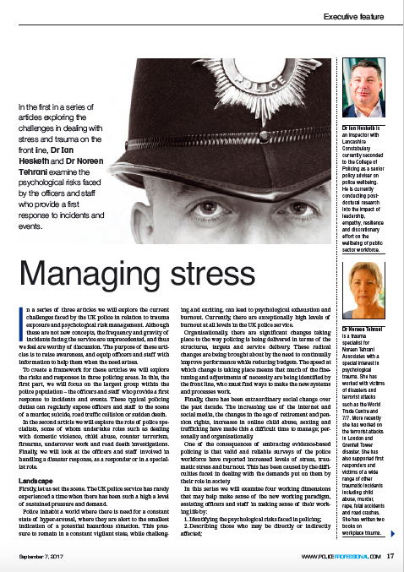
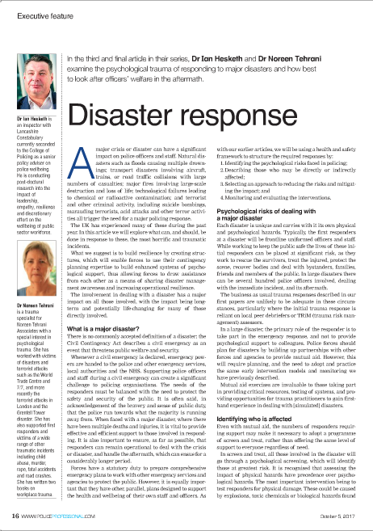
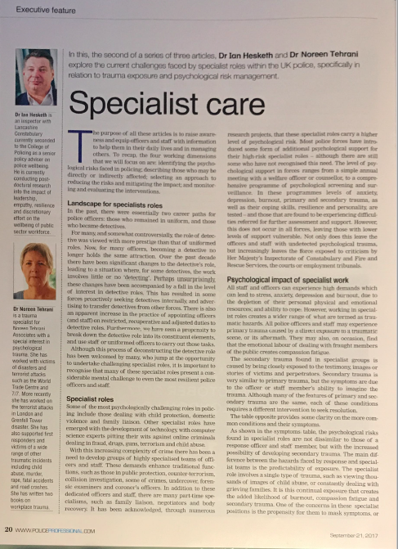

Slide 7
Included in this session
Policing Landscape
Standards
Education
Knowledge
Role of CoP
What the College of Policing does (and doesn’t) do
Knowledge
Standards
Education
Policing Landscape
Professionalisation Agenda
The College of Policing was established in 2012 as the professional body for everyone who works for the police service (43 forces) in England and Wales.

Slide 8
Role of the College of Policing
Our Purpose
To provide everyone working in policing with the skills and knowledge necessary to prevent crime, protect the public, and secure public trust.
Four complementary functions:
Knowledge – we develop the research and infrastructure for growing evidence of ‘what works’. Over time, this will ensure that policing practice and standards are based on knowledge rather than custom and convention.
Standards – we draw on the best available evidence of ‘what works’ to set standards in policing for forces and individuals. Examples include our Authorised Professional Practice (APP) and peer review.
Education – we support the development of individual members of the profession. We set educational requirements to assure the public of the quality and consistency of policing skills, and we facilitate the academic accreditation and recognition of our members’ expertise.
Building the College so we make a greater impact as an independent and authoritative professional body – for our members, this will provide improved physical and digital training environments, products and services which are easy to access and a College attuned to their needs.
Policing Landscape
Standards
Education
Knowledge
Role of CoP

Slide 9

Role of the College of Policing
Policing Landscape
Standards
Education
Knowledge
Role of CoP

Slide 10
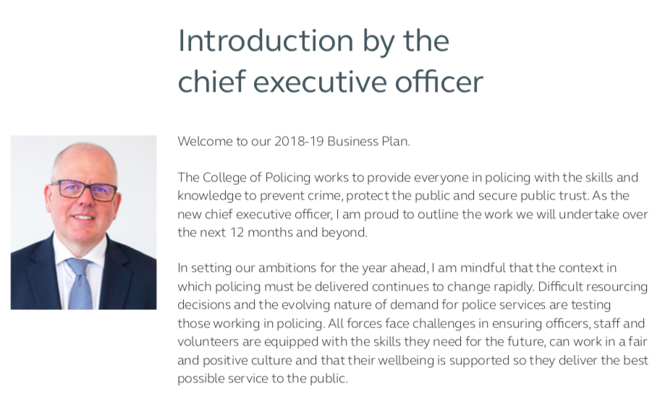
Role of the College of Policing
Policing Landscape
Standards
Education
Knowledge
Role of CoP

Slide 11
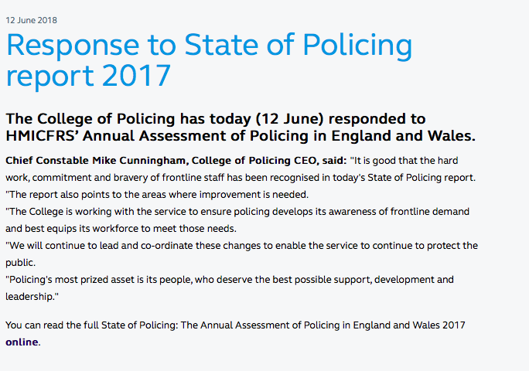
Role of the College of Policing
Policing Landscape
Standards
Education
Knowledge
Role of CoP

Slide 12
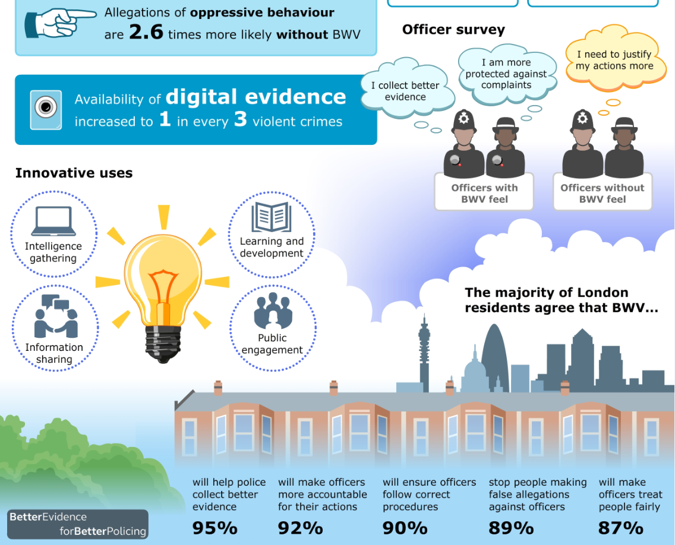
Knowledge
Policing Landscape
Standards
Education
Knowledge
Role of CoP

Slide 13
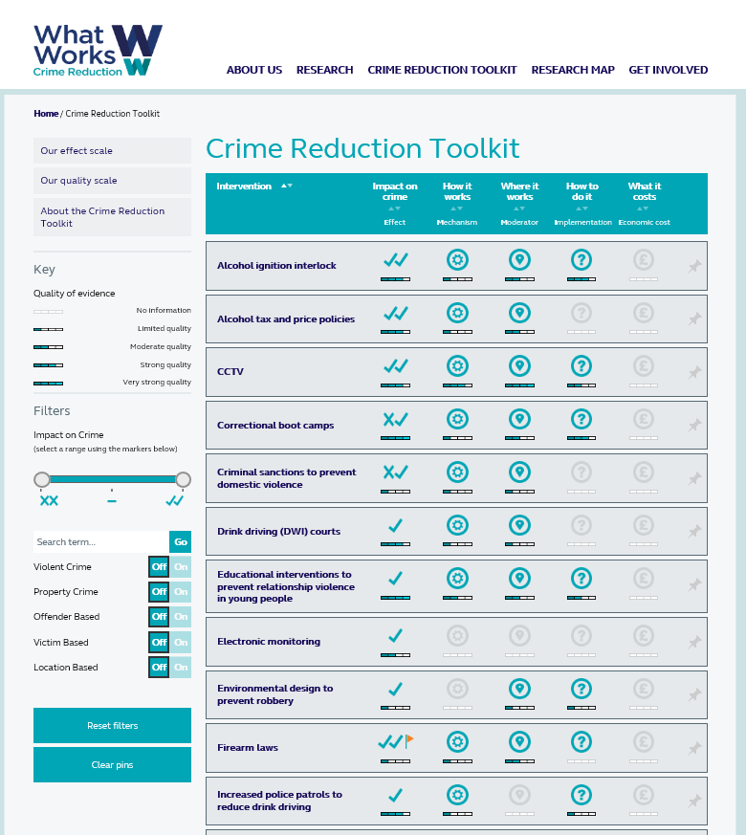
What Works Centre for Crime Reduction
Knowledge
Crime Reduction Toolkit
  The first comprehensive mapping of systematic review evidence in crime reduction.
Findings:
  Targeting hotspots, repeat victims and prolific offenders is efficient for known crime problems, although early preventive interventions are likely to be most cost effective.
  Police officers and staff can increase law-abiding behaviour through routine interactions members of the public, including offenders.
  CCTV & Street lighting

Slide 14
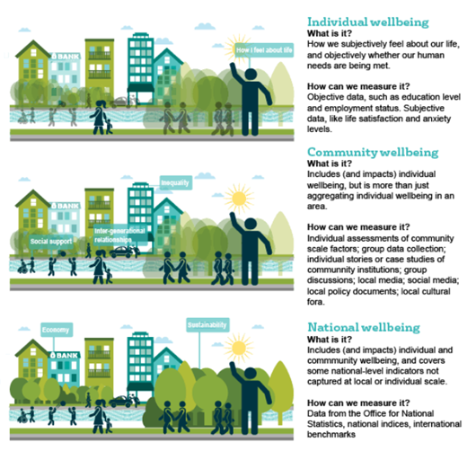
Knowledge
The What Works Centre for Wellbeing
Wellbeing across the whole of our lives
What is wellbeing
How to measure it
Community Wellbeing
People relationships
Built & natural environment
Power and decision making
Culture & Sport
Work
Adult Learning

Slide 15
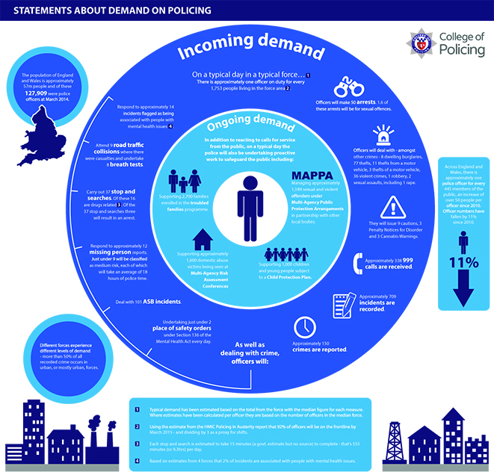
Knowledge
Policing Landscape
Standards
Education
Knowledge
Role of CoP

Slide 16
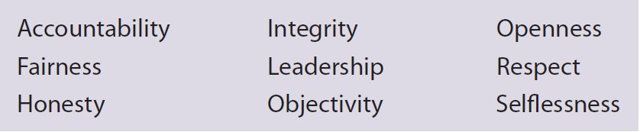
Code of Ethics
Standards
Policing Landscape
Standards
Education
Knowledge
Role of CoP
First Code of Ethics for Policing.
Nine Policing Principles.
Aims to support each member of the policing profession to deliver the highest professional standards in their service to the public.
Other ongoing integrity work:
Vetting Code of Practice and Authorised Professional Practice.
Whistleblowing Guidance

Slide 17
Authorised Professional Practice (APP)
Standards
Policing Landscape
Standards
Education
Knowledge
Role of CoP
Updated our APP on Child Sexual Exploitation twice to take into account recent operations.
Released APP on Domestic Abuse.
Completed a consultation on Mental Health APP.
About to lay a Vetting Code of Practice and Authorised Professional Practice.

Slide 18



Standards

Slide 19
Development of Training
Education
Policing Landscape
Standards
Education
Knowledge
Role of CoP
Worked with Safer Lives Charity to develop a training course on Domestic Abuse.
Developed the Mainstream Cyber Crime Training packages to help officers understand how to investigate online crime.
Delivered a suite of training products to help combat child sexual exploitation and abuse.
Developed a new training programme for every police force crime registrar to support greater consistency in crime recording across the country.
Delivered Strategic Command Course to all chief officers of the future.

Slide 20
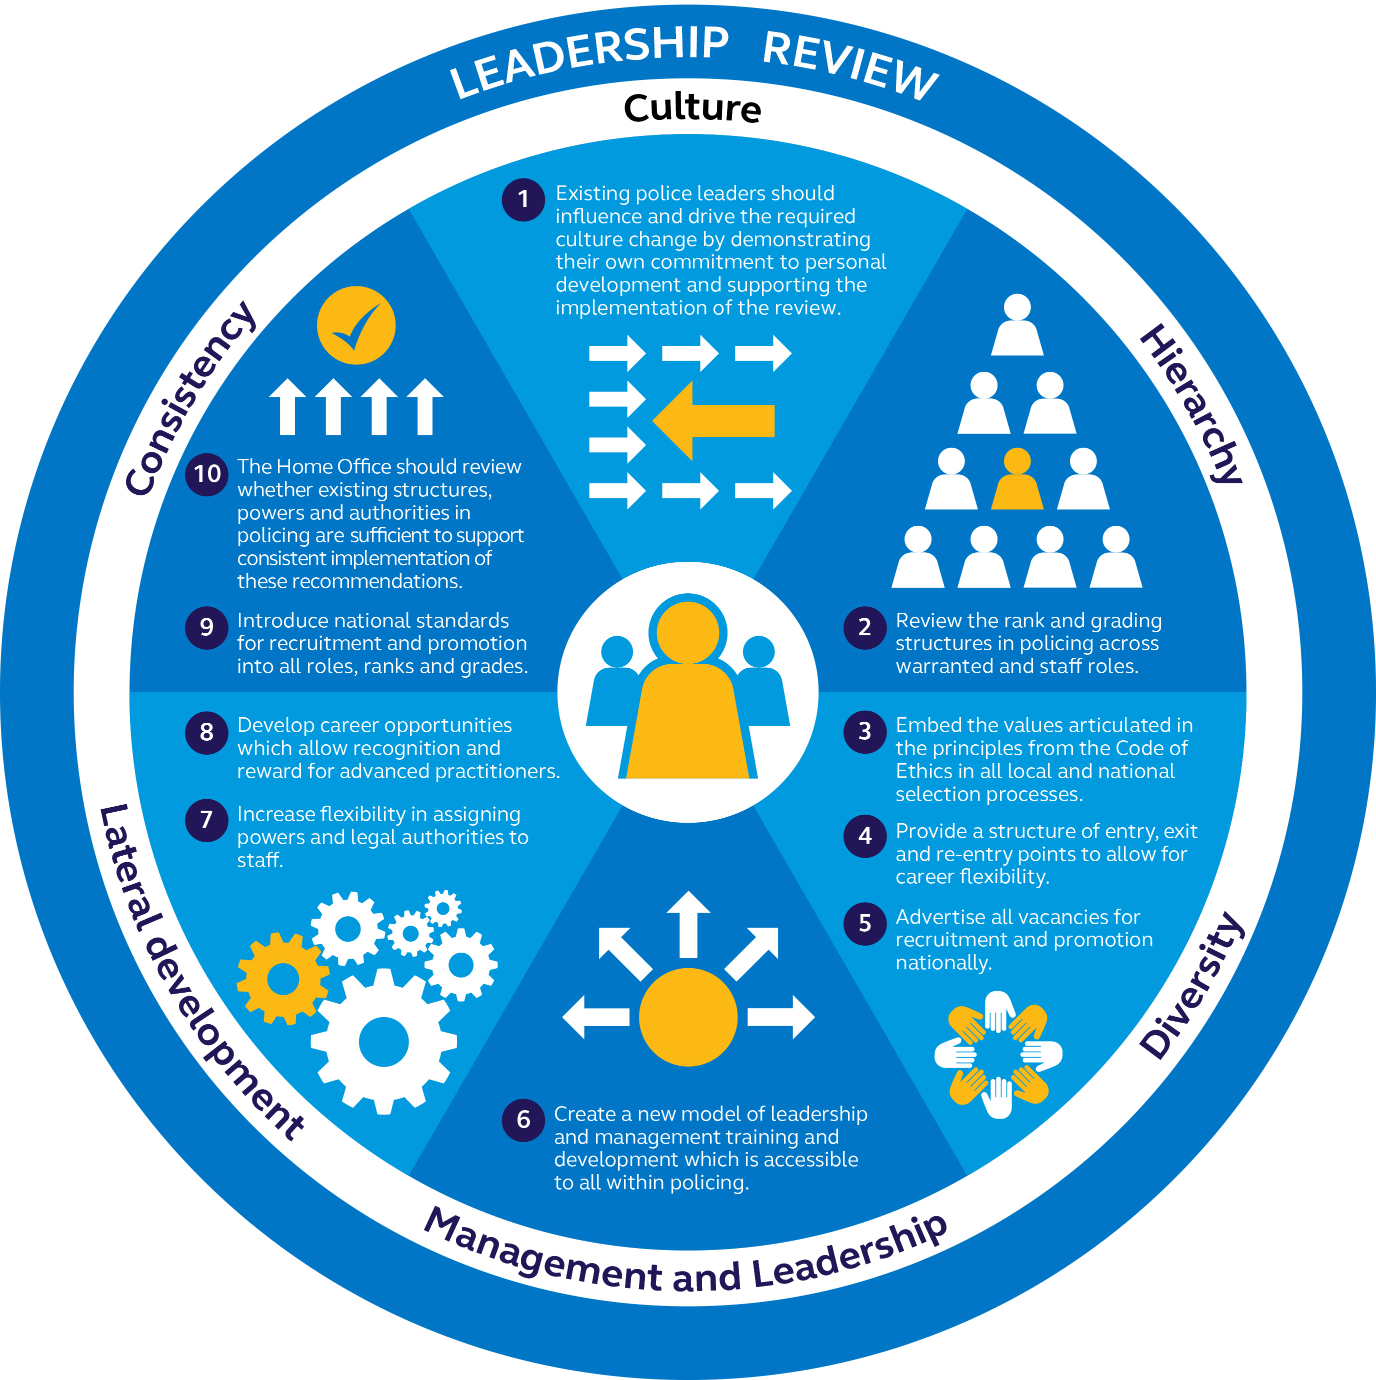
6 themes and 10 recommendations to support police leaders
Summary of
recommendations
Notes:
The evidence gathered during the review suggested that there was a need to promote positive practice in 6 broad areas:
Improving culture
Addressing unintended consequences of hierarchy
Increasing diversity and valuing difference
Giving attention to both management and leadership development
Recognising lateral development
Achieving greater consistency of practice across forces

Slide 21
Policing Education Qualification Framework
Education
Policing Landscape
Standards
Education
Knowledge
Role of CoP
The key proposals:
The establishment of a qualifications framework for policing, working in partnership with the higher education sector to set minimum education levels by level of practice or rank.
The development of opportunities for existing officers and staff to gain accredited and publicly recognised qualifications equivalent to their level of practice or rank.
The development of initial entry routes which involve self-funded undergraduate programmes, police-force funded graduate conversion programmes for graduates in other disciplines, and higher level apprenticeships (HLAs).

Slide 22
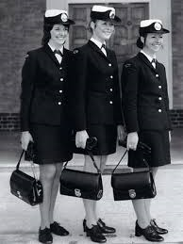
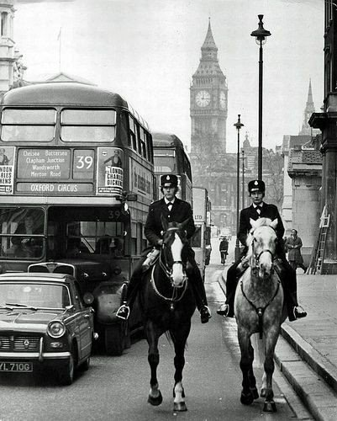
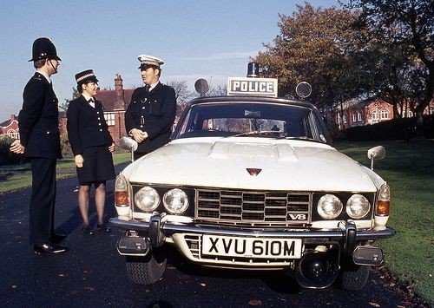
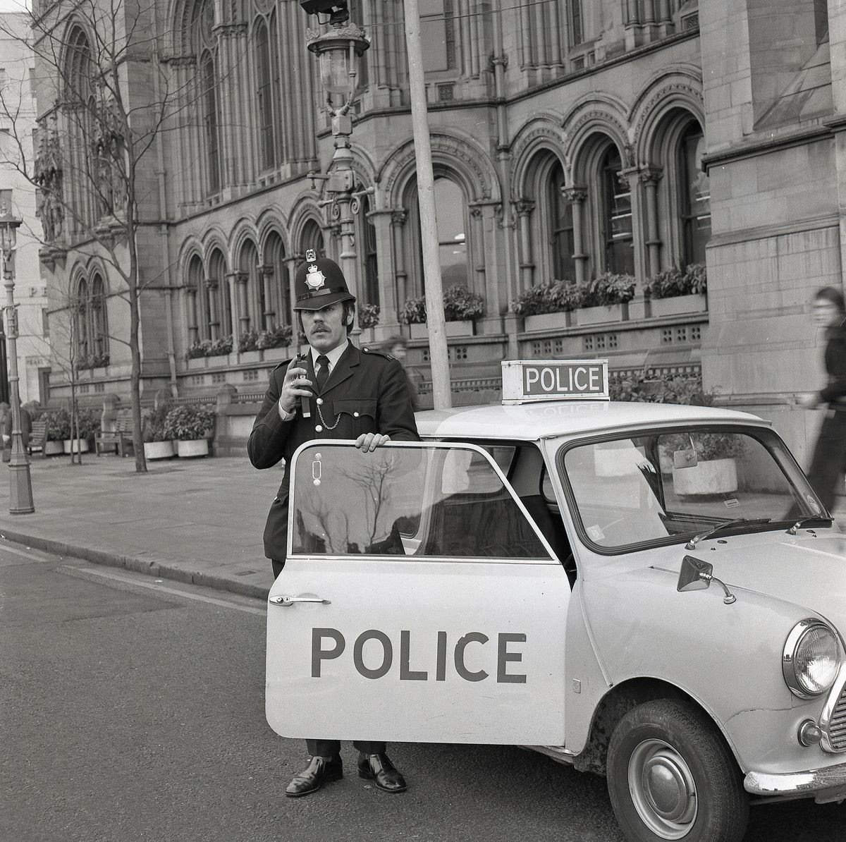
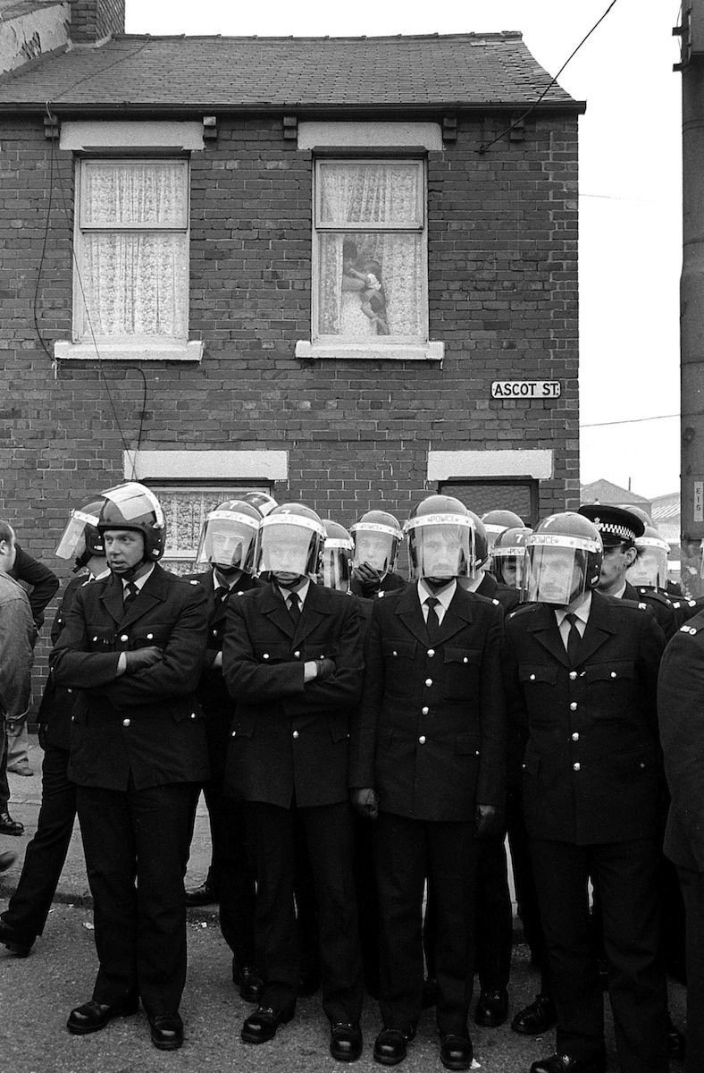
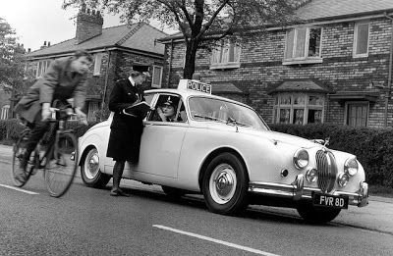
Changing face of Policing
40+ years ago
Policing Landscape

Slide 23
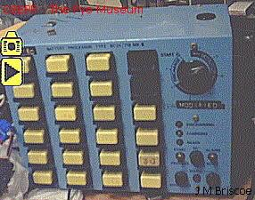
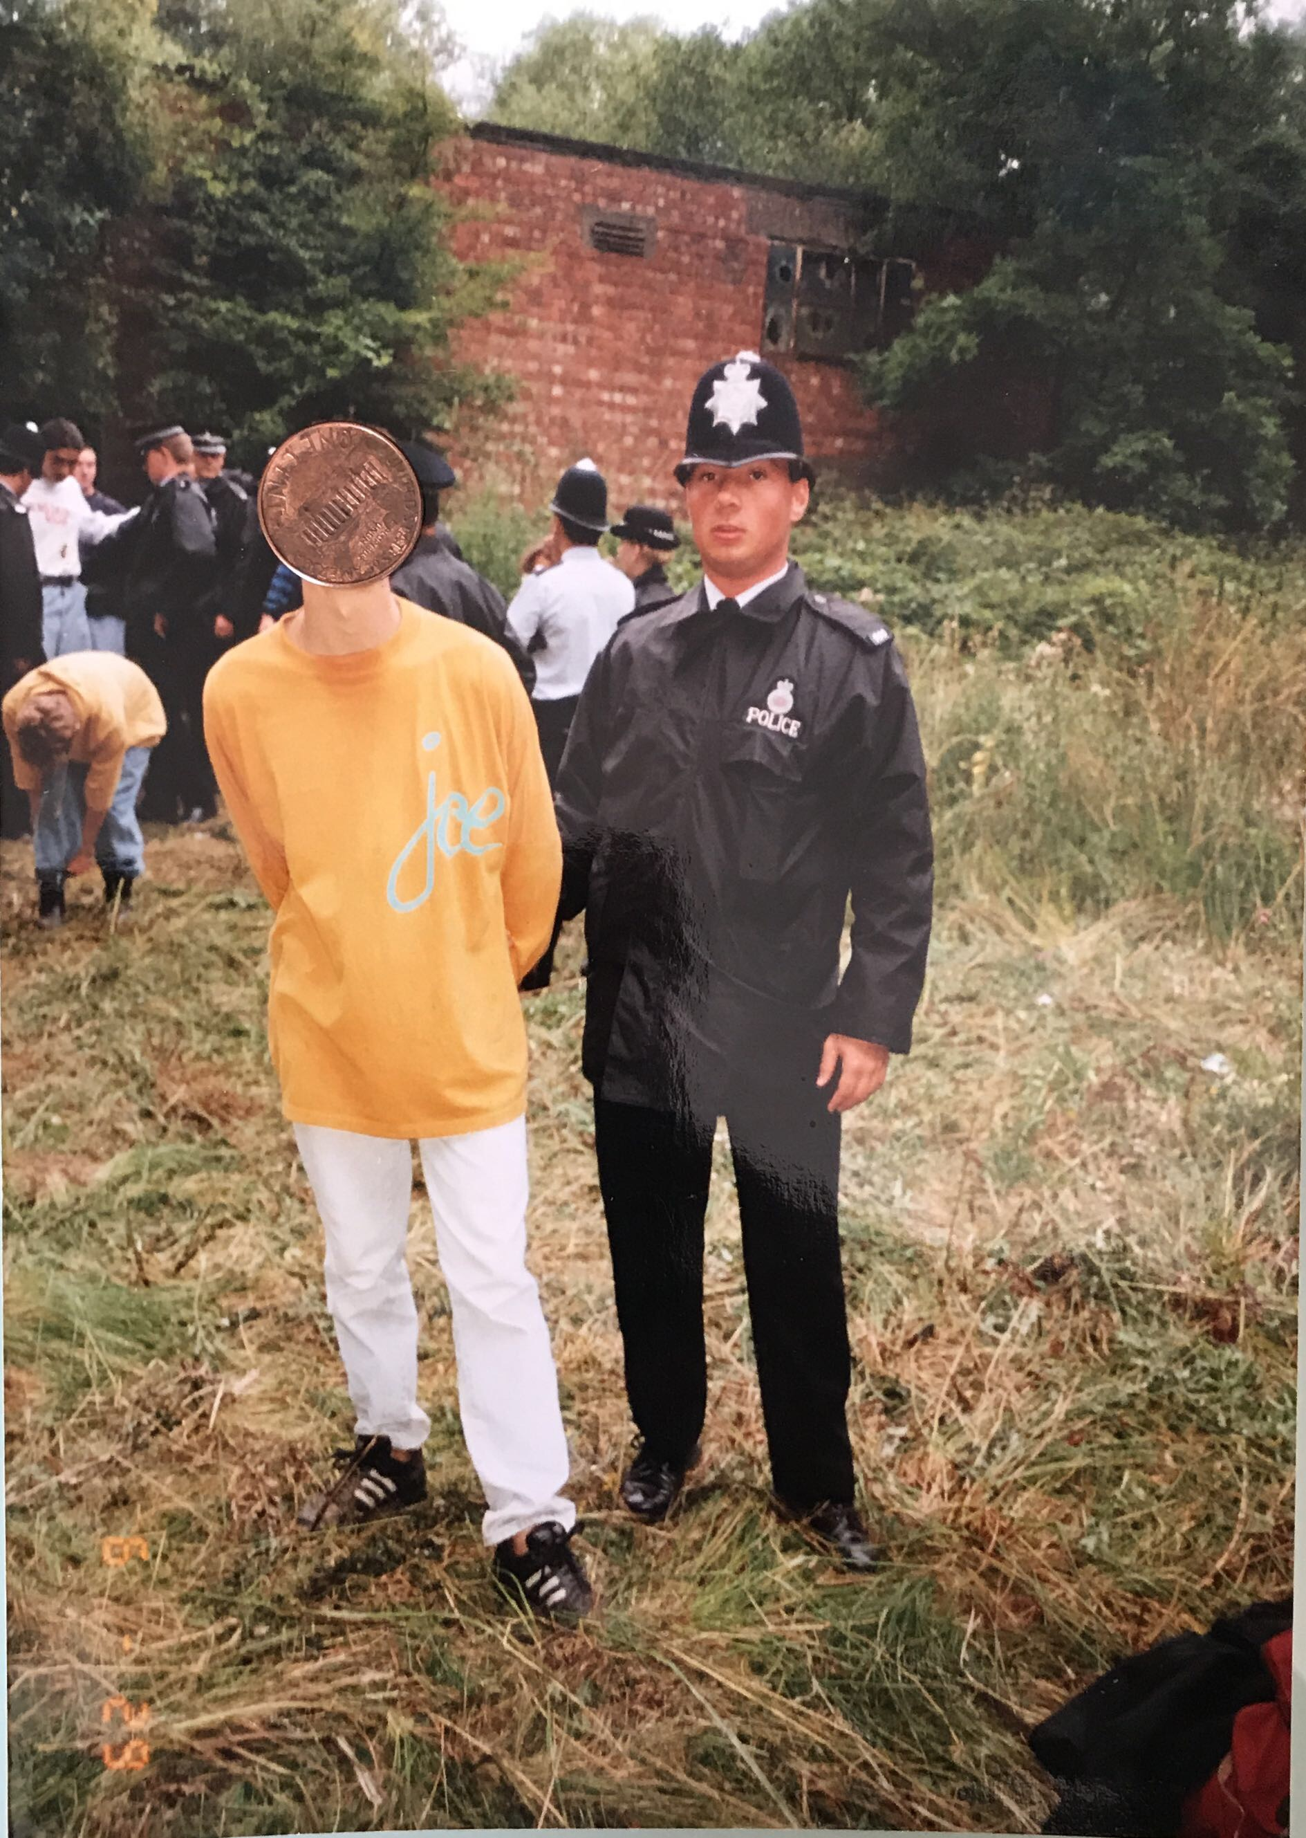
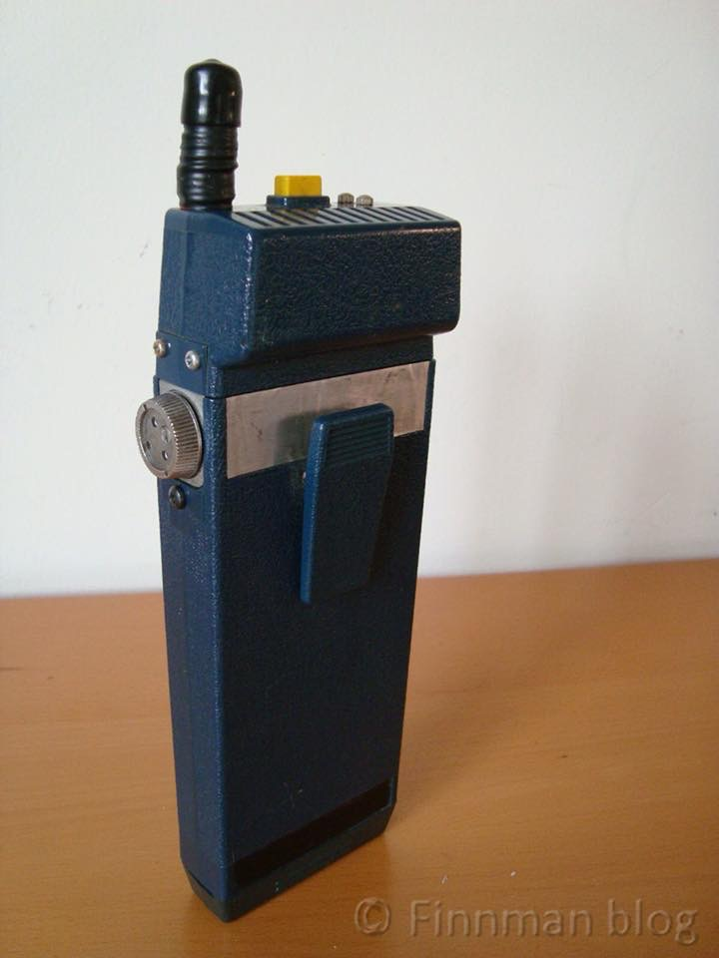
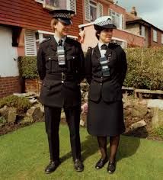
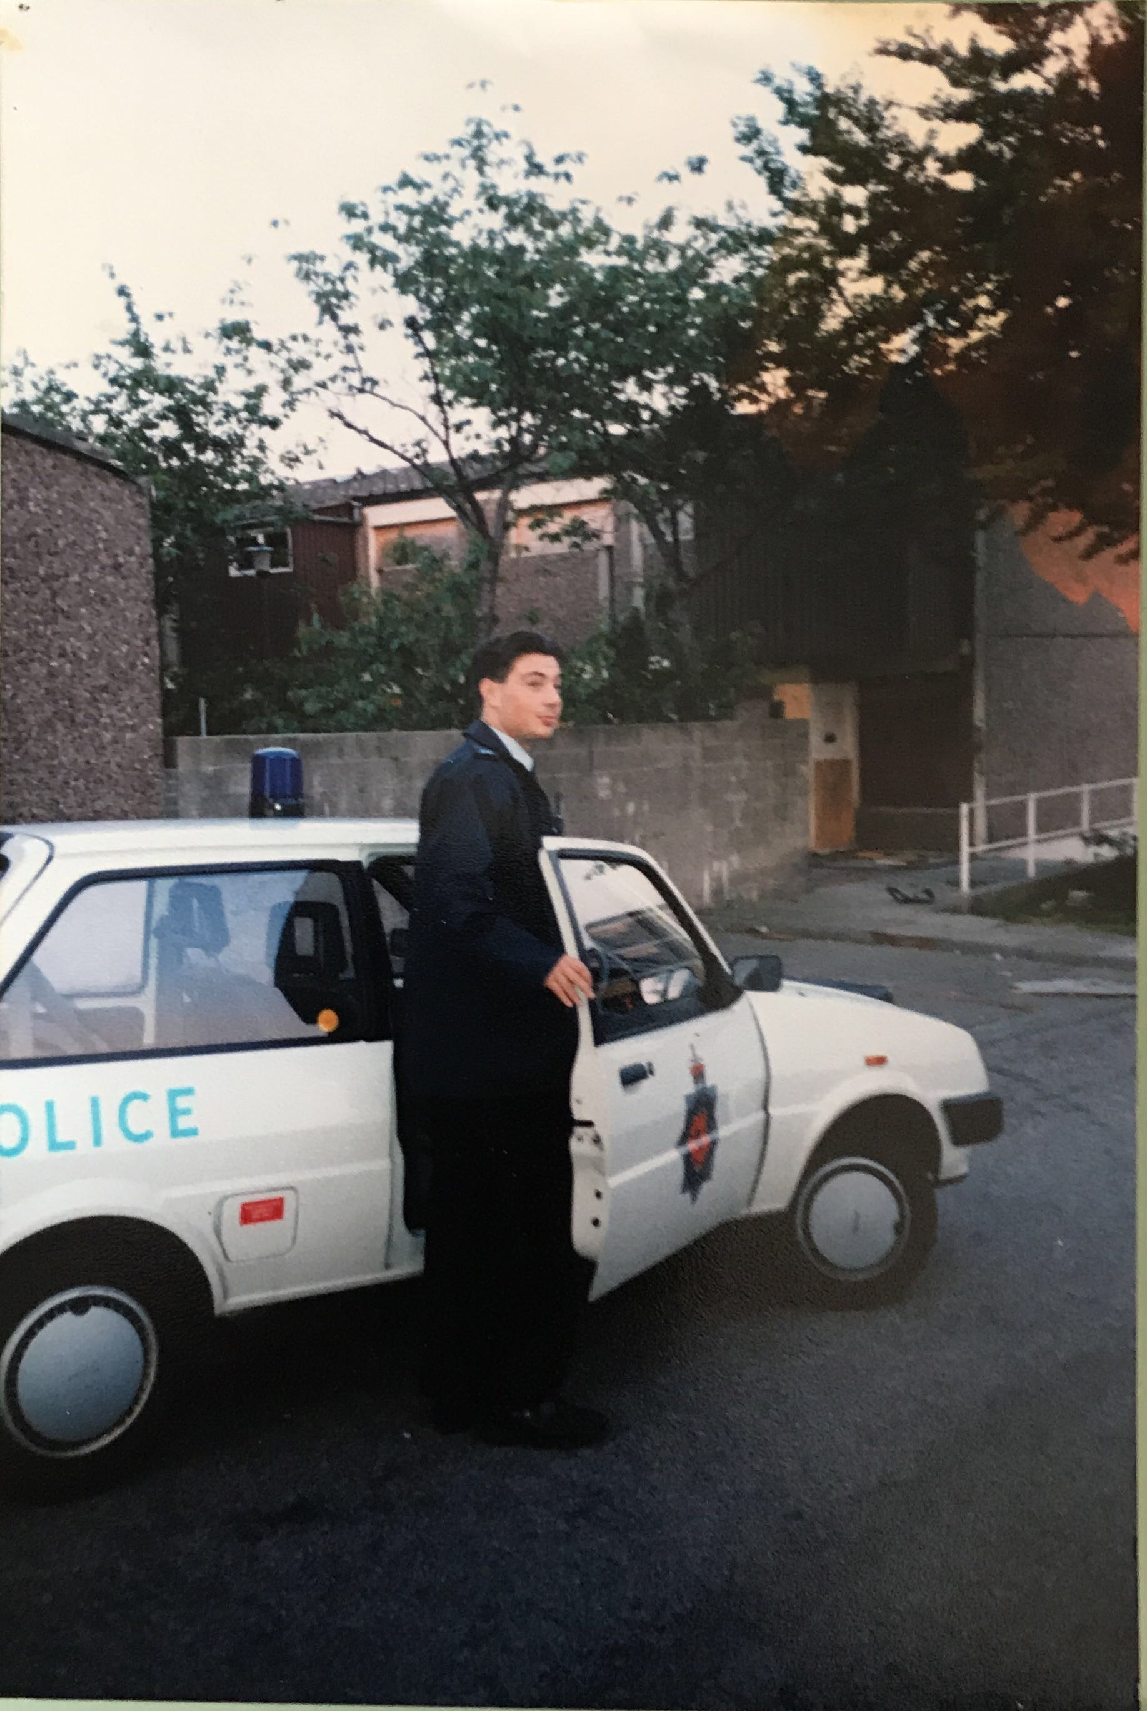
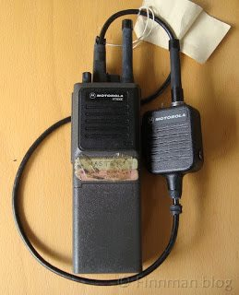
Changing face of policing
30 years ago…
Policing Landscape

Slide 24
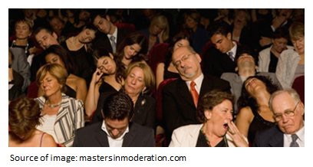
Policing Landscape
Policing Landscape
Standards
Education
Knowledge
Role of CoP

Slide 25
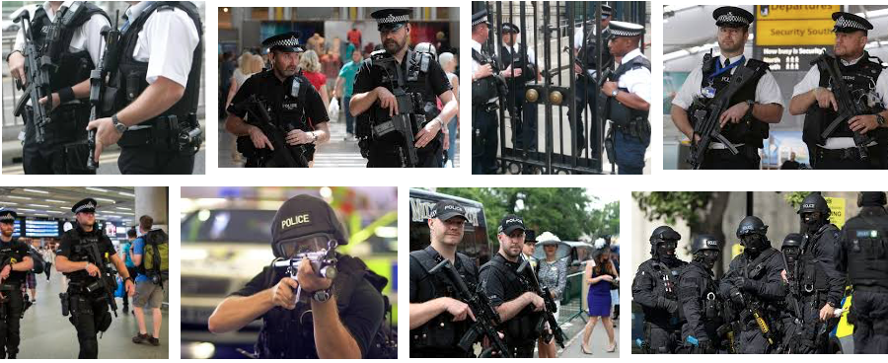
Policing Landscape - 2018

Slide 26
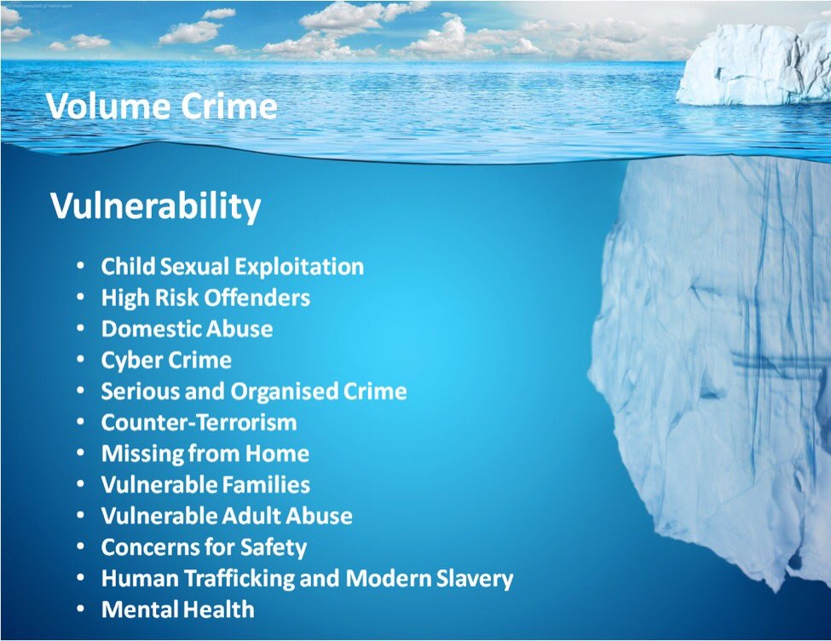
Policing Landscape
Policing Landscape
Standards
Education
Knowledge
Role of CoP

Slide 27
Policing Landscape
Policing Landscape
Standards
Education
Knowledge
Role of CoP
How Predictive?
Work
Volatility
Uncertainty
Complexity
Ambiguity
How much is known?
VUCA World (Casey,2014)

Slide 28
Professionalisation Agenda?
Policing Landscape
Standards
Education
Knowledge
Role of CoP
An occupation as a PROFESSION - who wants it, why, and how will this transform the service?
The PROFESSIONAL working within the profession, delivering different roles within the profession and what counts as a professional?
PROFESSIONALISM - what behaviours make up a professional, and how are they viewed, both internally and externally?

Slide 29


